Slide 1

Morgan Stanley SIBC Fall 2024
Fall 2024
Project Aardvark
Team Sneaky Steve
STUDENT INTERNATIONAL BUSINESS COUNCIL
‹#›

Slide 2







Owen Portelli
Morrissey Manor
Hamilton, Canada
Fun Fact: Allergic to sunscreen
Jack Burke
Sorin College
Cleveland, OH
Fun Fact: 7th Grade spelling bee champion (local level)
Nico Liparoto
Keenan Hall
Rochester, MI
Fun Fact: Walked a llama for over a mile
Timmy O’Connor
Dunne Hall
Potomac, MD
Fun Fact: AP recognized fastest in school, grades 4 – 7
Christine Reinhart
McGlinn Hall
Cincinnati, OH
Fun Fact: Broke both legs immediately after learning how to walk
Zaden Torres
Keenan Hall
Wauseon, OH
Fun Fact: Can guess (nearly) any movie from a single frame
Stephen Zeuthen
Keough Hall
Westwood, MA
Fun Fact: Can touch his nose with his tongue

Slide 3
Table of Contents
Executive Summary 4
AVAV Overview, A&D Industry Overview 7
AVAV Standalone Valuation 14
KTOS Company & Unmanned Systems Overview 19
KTOS Valuation 22
Investment Proposal: Carve-Out of KTOS Unmanned Systems Segment 26
Acquisition Highlights & Synergy Realization 34
Appendix A: AVAV Additional Supporting Materials 39
Appendix B: KTOS Additional Supporting Materials 63
Appendix C: AVAV / KTOS Acquisition Supporting Materials 74
Appendix D: Miscellaneous Additional Supporting Materials 80

Slide 4
I. Executive Summary

Slide 5
Executive Summary
AVAV Overview
AeroVironment (AVAV) is a leader in the government and commercial A&D industry, specializing in unmanned systems, and has secured long-term contracts and a strong customer base due to its early innovations in Small Unmanned Aerial Systems(SUAS) products
AVAV boasts strong multiples with AV/EBITDA reaching 50.3x for 2024, significantly higher than the comparable companies average of 15.3x
Industry Overview
The A&D industry is heavily influenced by government spending and geopolitical tensions. Additionally, it is characterized by significant R&D costs, long order backlogs, and favors consolidation
The government has demonstrated a strong preference for unmanned systems, as evidenced by joint R&D initiatives focused on the development of unmanned aerial vehicles
KTOS Overview
Kratos Defense & Security Solutions (KTOS) is a leading provider of advanced defense technologies, with two primary business segments: Government Solutions and Unmanned Systems
KTOS is recognized for its focus on speed and affordability, setting an unprecedented standard within the industry
Acquisition of KTOS UxS Segment by AVAV
KTOS’s UxS segment, known for its high-speed, affordable technologies, would complement AVAV’s existing portfolio, allowing the company to diversify its products while capitalizing on shifting consumer and market preferences
The integration of KTOS’s advanced unmanned systems technologies with AVAV’s market-leading innovations would provide both companies with an opportunity to enhance R&D synergies and accelerate product development
Pro Forma Valuation
The combined net income of AVAV and Kratos UMS (KTOS) is projected to grow significantly, from $110.1 million in 2025 to $239.8 million in 2030, driven by the synergies and integration of the UMS segment
The implied EBITDA multiple for the transaction in 2025 is projected to be 31.1x, reflecting strong growth expectations for the combined entity

Slide 6

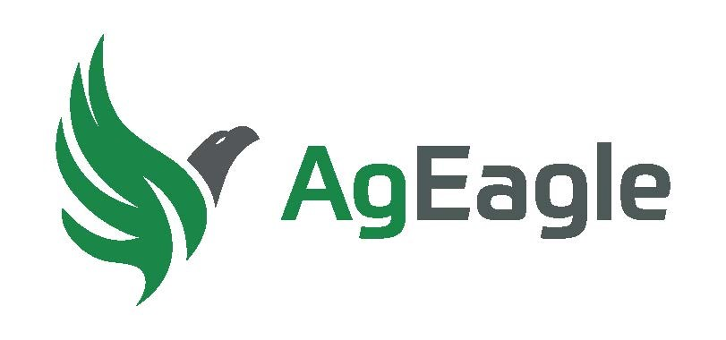
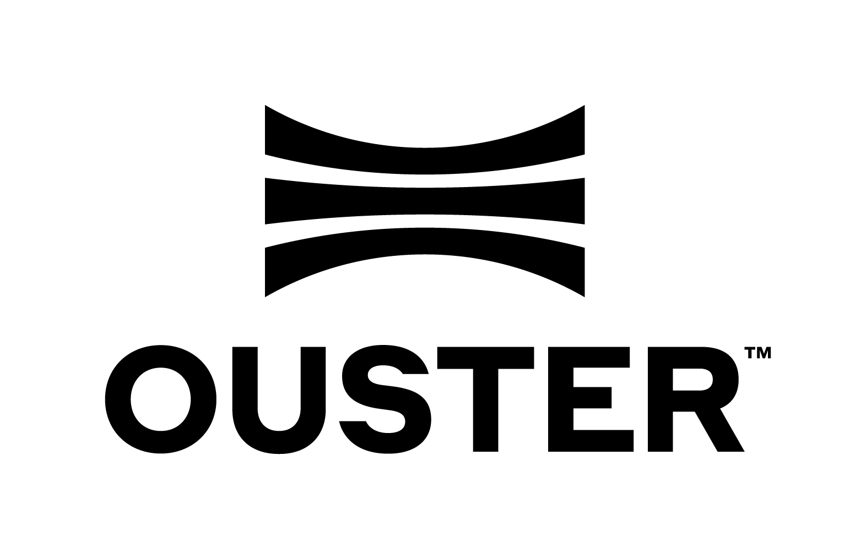

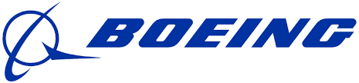
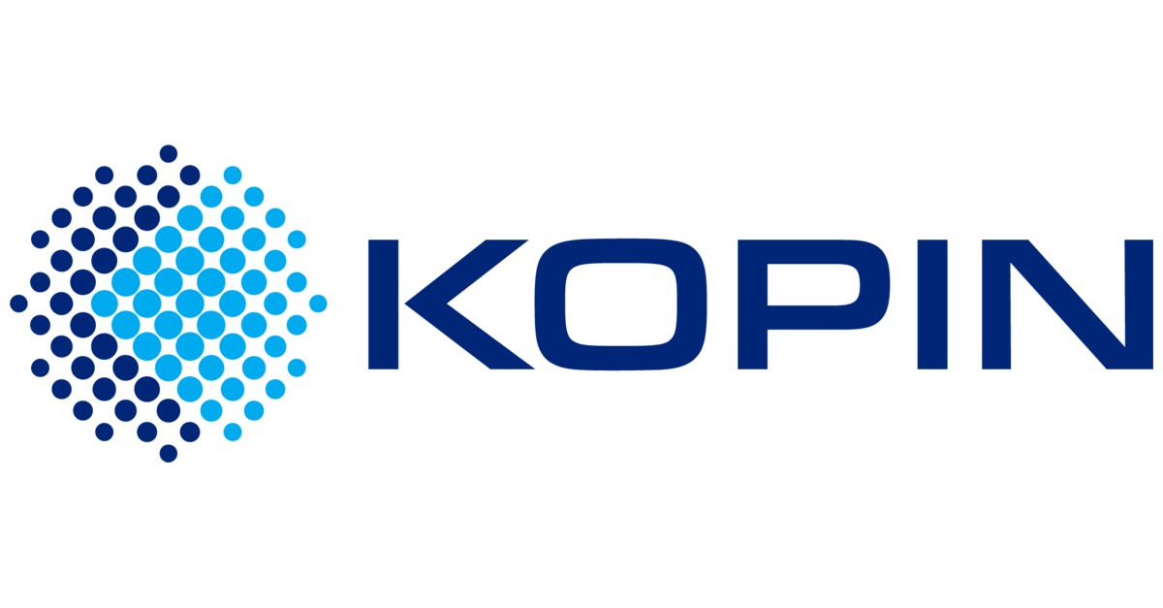
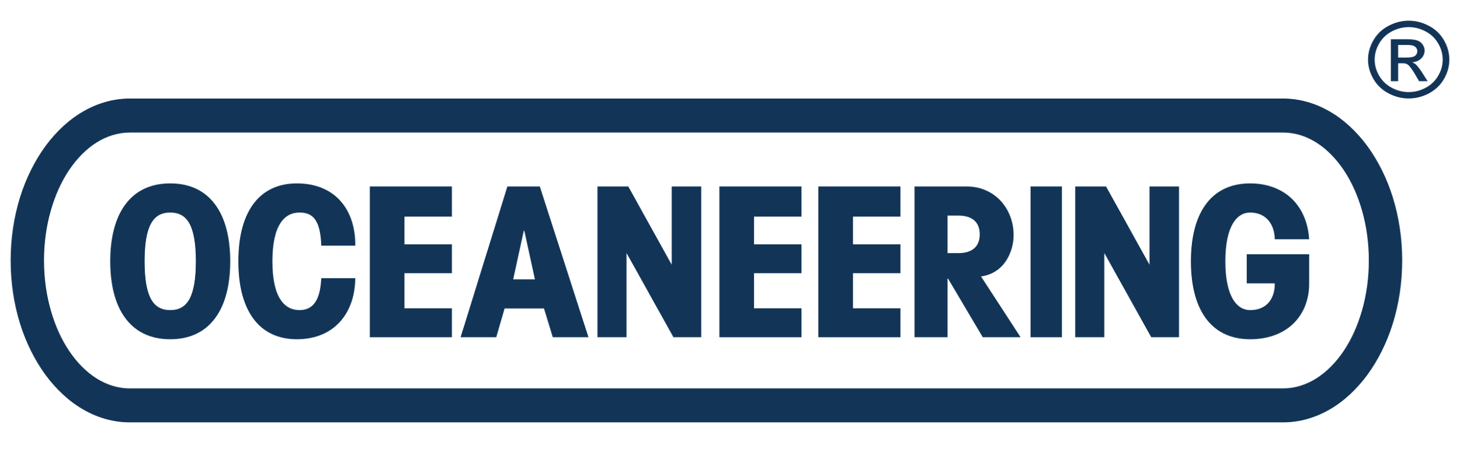

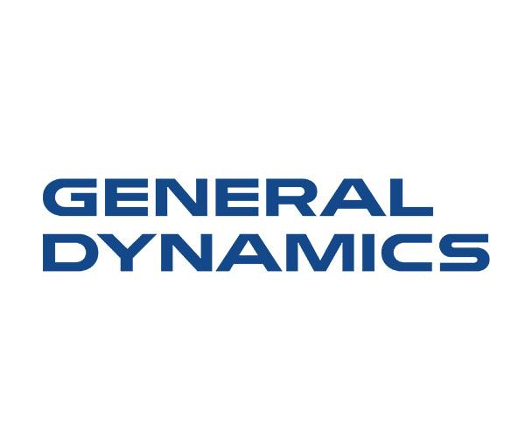
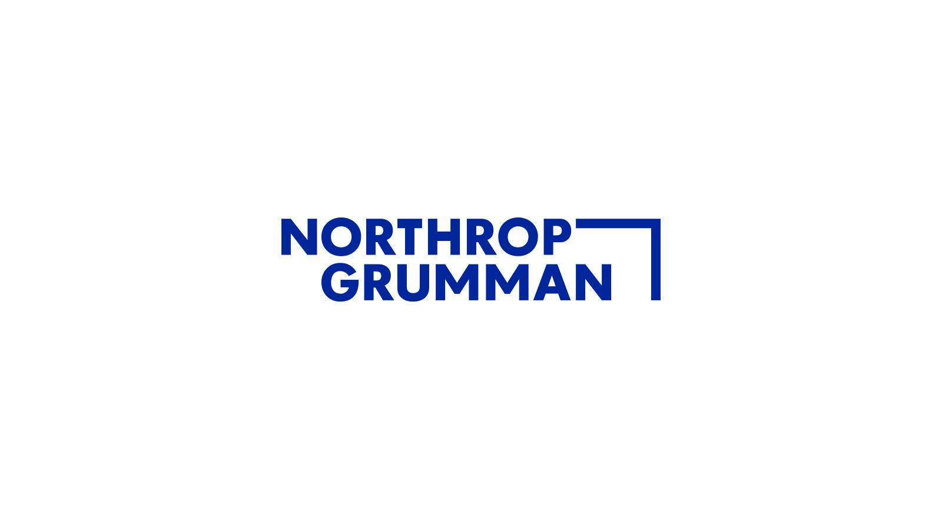
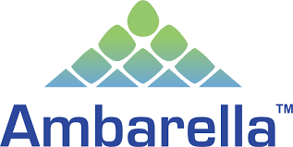
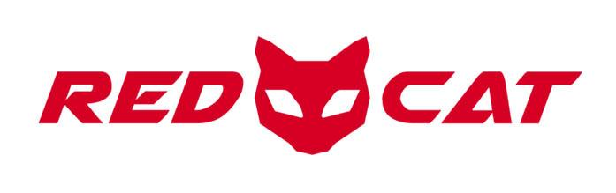
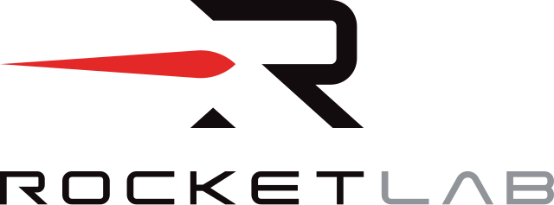
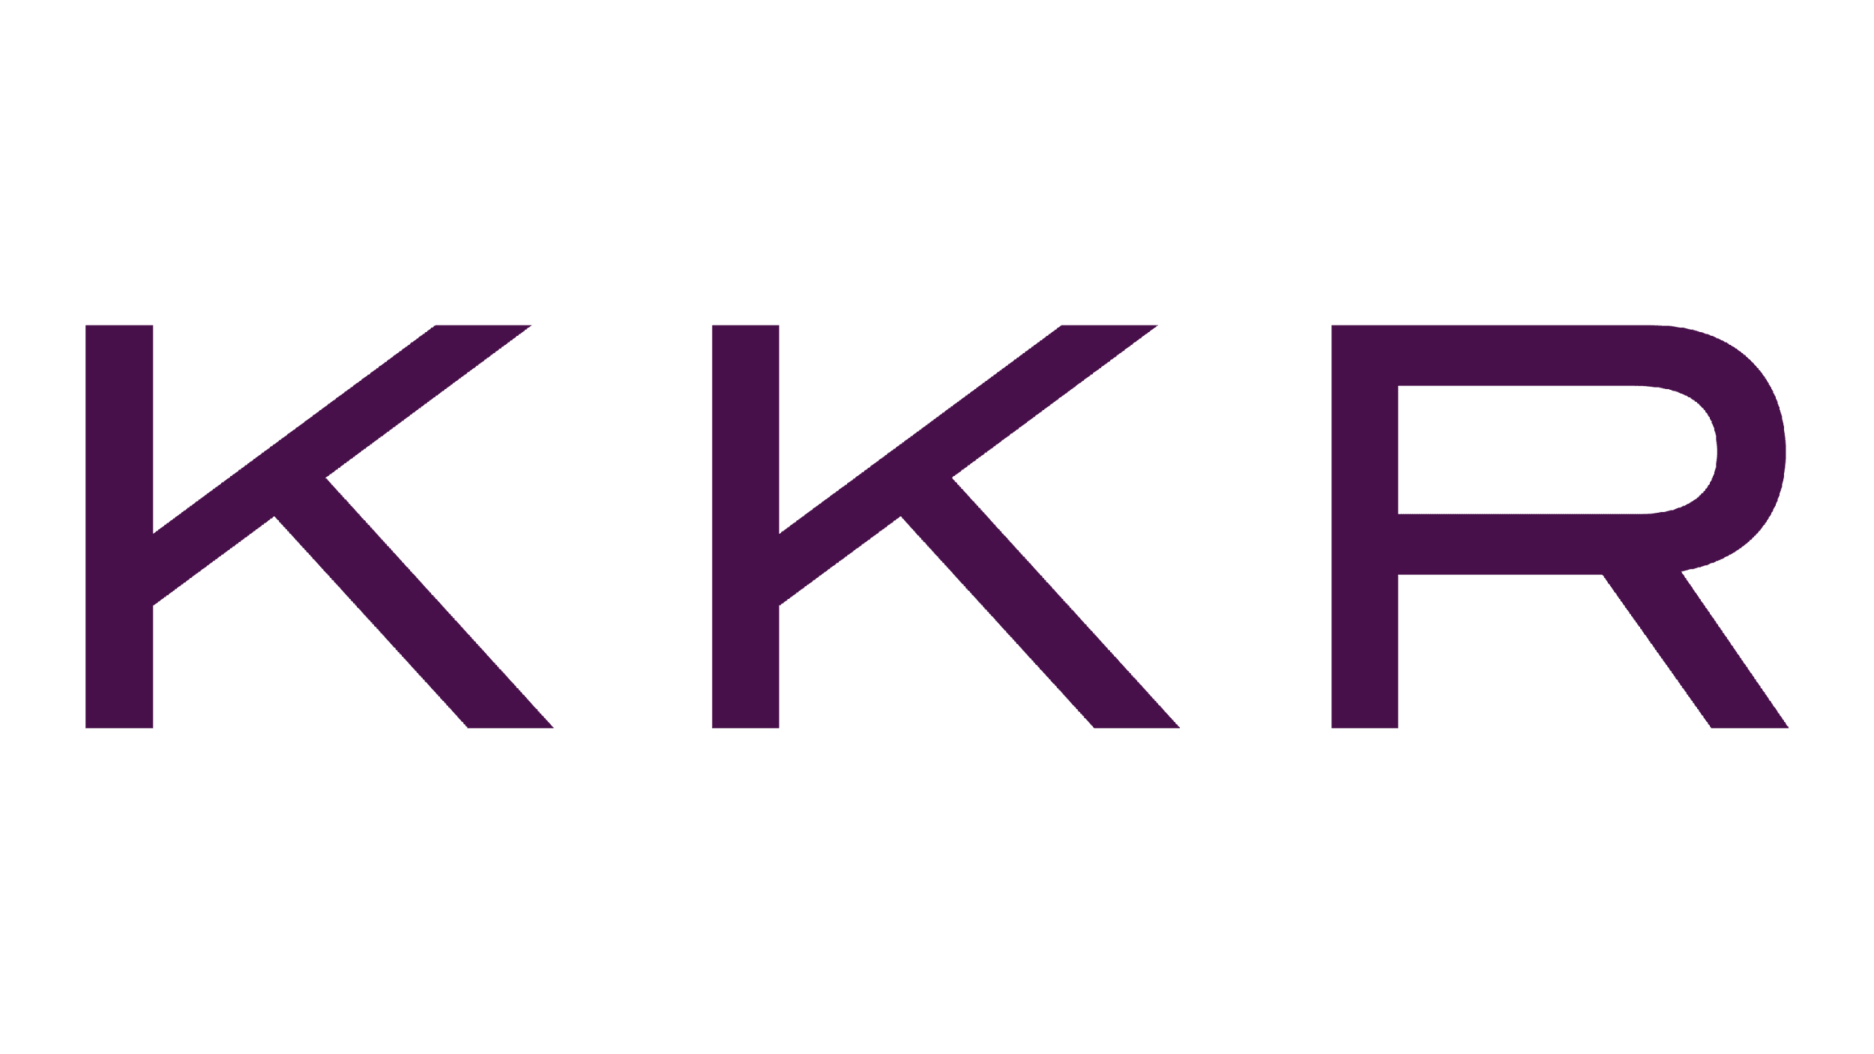
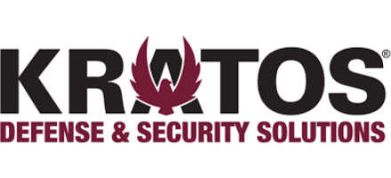


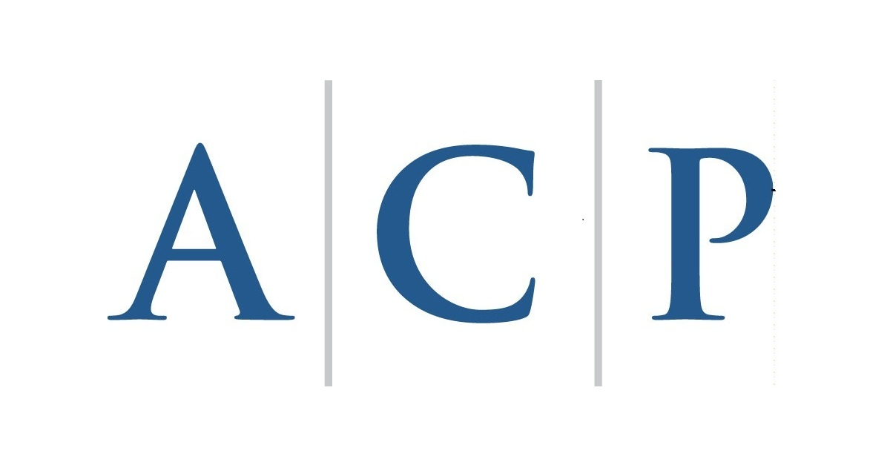
All Strategic Alternatives Considered
Sale to a Strategic Buyer
Acquisition
Sale to a Private Buyer
Carveout of Kratos’ Unmanned Systems Segment

Slide 7
II. AVAV & A&D Industry Overview

Slide 8
AVAV Overview
AVAV Situation Update
UAV Sub-Industry Overview
AeroVironment, Inc. Company Overview
AeroVironment specializes in uncrewed surveillance and weapons systems, pursuing growth through innovation and contracts
Company Snapshot
Product Mix
AeroVironment, Inc. (NASDAQ: AVAV) specializes in designing, developing, producing, and supporting unmanned systems, weapon systems, and other related services for government and commercial clients
Headquartered in Arlington, VA, and employs approximately 1,403 people full-time
In August, AeroVironment was awarded a $54.9 MM delivery order for Switchblade® loitering munition systems as part of a larger contract with the U.S. Army which has a ceiling value of $990 MM
Uncrewed Systems (UxS)
Comprised of small uncrewed aircraft systems, medium uncrewed aircraft systems, and uncrewed ground vehicles
Loitering Munitions Systems (LMS)
Weapons designed to loiter in the air for extended periods, locate a target, and strike with precision by self-destructing upon impact
MacCready Works (MS)
Includes proprietary programs, advanced research, Ingenuity Mars Helicopter, and High-Altitude Pseudo-Satellites businesses
Management Spotlight
Wahid Nawabi, CEO, 2016 – Present
Under his leadership, AeroVironment has significantly grown its portfolio of unmanned systems, including the Switchblade® loitering munition system
Kevin McDonnell, CFO, 2017 – Present
Has been instrumental in overseeing strategic acquisitions such as the 2021 acquisition of Arcturus UAV, Inc.
Growing Investment into R&D ($MM)
Capitalization Summary
52.0% increase due to the development of new product lines and additional support for acquisitions
52.0%
Share Price | $216.00
Shares Outstanding | 28.0 MM
Market Capitalization | $6,048 MM
Total Debt | $47.3 MM
(Cash and Cash Equivalents) | ($81.2 MM)
Aggregate Value (AV) | $6,014 MM
CAGR 8.4%
Sources: Company Materials, CapIQ

Slide 9
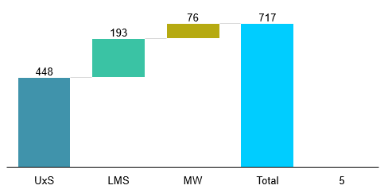
AVAV Overview
AVAV Situation Update
UAV Sub-Industry Overview
Segment Breakdown
Attention to research and development positions AVAV to grow across their three segments
Segment Revenue 2024
Revenue Type by Segment 2024
$MM
%
UnCrewed Systems
Loitering Munition Systems
MacCready Works
Design, development, production and deliverance of unmanned aircraft (SUAS/MUAS) and ground robot systems (UGVs)
Provide reconnaissance and surveillance as an attempt to mitigate risk to living operators
Growing capabilities for both defense and other markets given increases in technology and AI
Development of high-speed precision missiles typically deployed during time-sensitive intense situations
Seen as cost-effective alternative to existing missile systems. Easily transported, launched quickly, and potential for recalling
Three main offerings of Switchblade 300, Switchblade 600 and Blackwing provide solutions for situations across sea and land
Segment focused on long-term growth through extensive R&D projects
Customer-funded projects focused in robotics, AI, sensors, software analytics and connectivity
Large addressable market remaining outside US and allies
Potential to significantly improve existing products’ efficiency, targeting, and autonomy
Sources: Company Filings

Slide 10

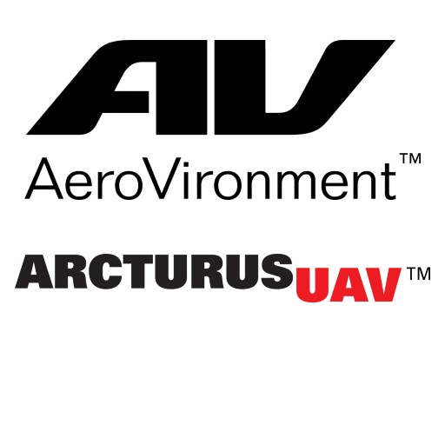

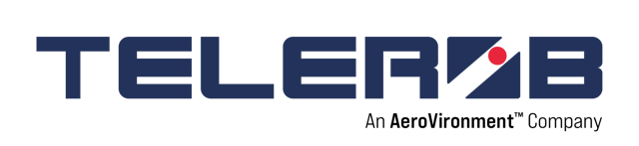
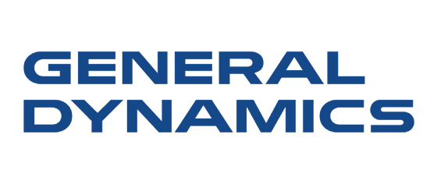
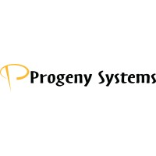
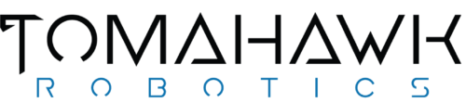
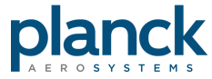
AVAV Overview
AVAV Situation Update
UAV Sub-Industry Overview
Consolidation Efforts Drive Growth
Discontinued Segments
UxS
AeroVironment’s recent M&A transactions suggest the company is looking to advance its UxS segment
LMS
MS
Jun. 2018
Sold its Efficient Energy Systems to Webasto, an EV charger producer
Dec. 2020
Acquired Telerob, a remote-controlled unmanned ground systems manufacturer
Jun. 2019
Acquired Pulse Aerospace, an unmanned helicopter manufacturer
Jan. 2021
Acquired Arcturus UAV, a producer of UAS system technologies
Aug. 2023
Acquired Tomahawk Robotics, an AI-driven unmanned systems producer
Aug. 2022
Acquired Planck Aerosystems, a drone navigation solutions provider
Aug. 2022
Sold Progeny Systems to General Dynamics, an aerospace corporation
Feb. 2021
Acquired Progeny Systems, a supplier of software and hardware solutions
Sources: Company Filings, Bloomberg, S&P Capital IQ

Slide 11




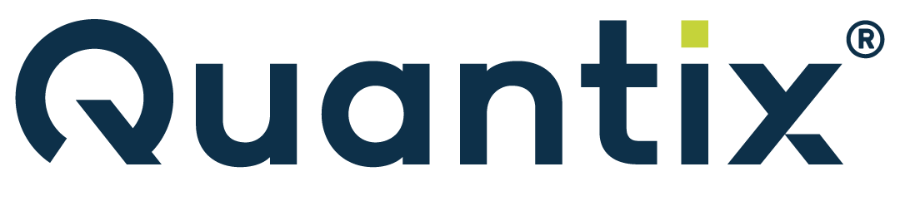
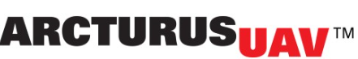
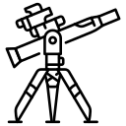


AVAV Overview
AVAV Situation Update
UAV Sub-Industry Overview
AVAV Situation Update
AeroVironment's dynamic presence within UxS and LMS makes it well positioned for long term success in the defense sector
AVAV’s Place in the Industry
Revenue ($MM) Segmentation
Industry Dynamics
The UAV space is projected to grow at a CAGR of 9.9% to 2029
Tailwinds in the legislation space due to LASSO, the Army LRPM, and the U.S. DoD Replicator Initiative
Geopolitical conflict has accelerated the usage of LMS and UxS systems
Small UAVs boast highest growth opportunities due to maneuverability and low operational costs
CAGR: 16.6%
$823
$715
$541
$446
AVAV’s strong presence
Most recently secured an Army contract with a $990 MM ceiling to provide Switchblade LMS systems
Expertise with small UAV offerings: Raven, Puma, Wasp
Innovate capabilities fueled by R&D, which was 14% of revenue in 2024 and far higher than competing contractors
Industry leader in autonomous solutions and manufacturing scale
Growth Avenues for Expansion
Past Acquisitions
Advanced training
Medium UAVs
Satellites
2018
2018
2021
Enhanced sensing
Cybersecurity
Missile defense
Sources: Company 10K, JPMorgan

Slide 12
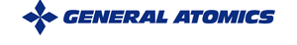
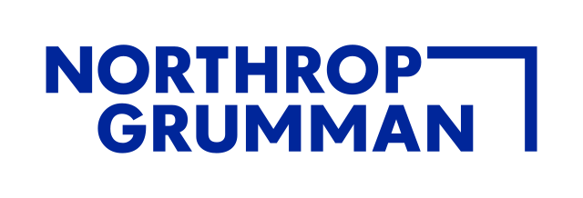

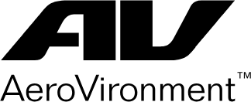
AVAV Overview
AVAV Situation Update
UAV Sub-Industry Overview
UAVs: The Future of Combat
In the niche space of UAVs and UAS systems, AeroVironment has had a strong historical presence in a promising, innovating sector
Technology Timeline
AVAV built first solar powered UAV
Acceleration of SIGINT payloads
MQ-4C Triton system launch for high altitudes
AI, swarm tech, and advanced sensing
As a constant area of technological innovation over the past few decades, UAVs and corresponding UAS systems are likely to see strong revenue growth as products become increasingly advanced
1994
2006
2015
1983
2001
2012
2024
RQ-1 Predator launch with HD imaging
UAVs face regulatory hurdles with high demand
Defense Innovation Unit created for UAV tech
Leaders in the UAV Space
Regulatory Environment
National Defense Authorization Act in 2024 prevents purchase or operation of UAVs in countries deemed hostile to the US
The Arms Export Control Act (AECA) through international traffic regulations gives presidential authority over UAV imports and exports
The Missile Technology Control Regime (MTCR) also prevents proliferation of unmanned systems to other countries
NASA, Homeland Security, military branches work in unison to regulate defense contractors
Presidential administrations often influence restrictions on UAVs heavily
Leading the UAV space with a ~14% market share and producer of key systems such as the Predator and Reaper
Closely following General Atomics with a 12% market share, Northrop Grumman has been a long time leader within the space
Known for its easily-usable LRS, Textron has captured ~10% of the UAV/UAS market
AVAV has a reputation for excellence within the tactical and low altitude space and higher margins
Source: IBISWorld

Slide 13
AVAV Overview
AVAV Situation Update
UAV Sub-Industry Overview
UAV Industry Dynamics: Scale Wins
The UAV industry is expected to see decreased revenue in future years as the largest players consolidate and leverage economies of scale
Overview
Unmanned Aerial Vehicle Revenue ($Bn)
The DoD accounts for most of the UAV industry’s revenue and the four largest UAV manufacturers, General Atomics, Northrup Grumman, Textron, and AVAV, are set to generate 69.3% of industry revenue
The UAV industry is expected to take part in a wider trend of consolidation among defense contractors as large players attempt to lower costs through economies of scale and increase UAV capabilities
Federal Funding for Defense ($Bn)
Defense spending on UAVs has seen an overall decline following the strong growth in 2023 as operations in the Middle East have declined, but the Russia-Ukraine conflict will still support demand
‘20A-’25E CAGR: 1.4%
’25E-’30E CAGR: 1.3%
Products Segmentation ($Bn)
Source: IBISWorld
Notes:
The defense budget is expected to grow with small nominal growth in operations and maintenance expenses as well as the ongoing war in Ukraine, the war between Israel and Hamas, and the potential threat that China presents in Taiwan may lead to defense spending
AVAV is a leader in the low-altitude UAV segment and acquiring Kratos’ unmanned systems segment will enable AVAV to expand further into the medium-altitude long-endurance, MALE UAVs, segment

Slide 14
III. AVAV Standalone Valuation

Slide 15
AVAV Projections
AVAV Valuation
Description of AVAV Financial Forecasts
AeroVironment Consensus Case
AeroVironment Management Case
Overview
FY 2025E – 2027E projections provided by S&P Capital IQ
FY 2025E – 2029E projections provided by SIBC with guidance from AeroVironment’s management projections
Revenue
Revenue growth will fluctuate between 11.3% and 25.2% through 2027E
Revenue growth will fluctuate between 15.2% and 32.6% through 2030E
Gross Margin
Gross Margin in 2025E is 40.1% and remains relatively stable through 2027E
Gross Margin in 2025E is 36.0% and remains relatively stable through 2030E
SG&A (as % of Revenue)
Selling, General, and Administrative as a percent of revenue will be 13.8% in 2025E and experience a slight climb to 14.9% in 2027E
Selling, General, and Administration as a percent of revenue will be 14% in 2025E and remain stable through 2030E
Operating Margin
Operating Margin will rise to 10.8% in 2025E and experience a slight climb to 12.7% in 2027E
Operating Margin will decrease to 8.0% in 2025E and drop to 4.5% in 2030E
EBITDA Margin
EBITDA Margin will rise to 18.2% in 2025E and experience a slight climb to 18.7% in 2027E
EBITDA Margin will rise to 11.2% in 2025E and experience a decline to 8.5% in 2030E
Source: S&P Capital IQ

Slide 16
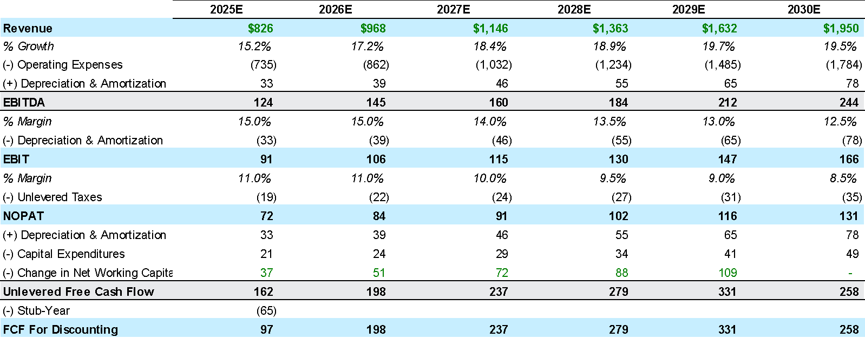
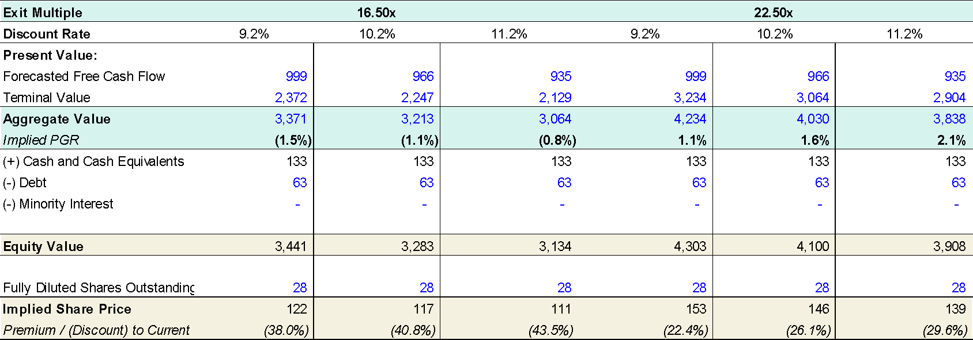
AVAV Projections
AVAV Valuation
AVAV DCF Valuation – Management Case – Exit Multiple Method
Key Assumptions:
Valuation Date: November 11, 2024
Effective Tax Rate: 21.0%
WACC range of 9.2% - 11.2%
Terminal value based on exit multiple method (16.50x and 22.50x)
Final projection year: April 30, 2030
No adjustments for midyear convention

Slide 17
AVAV Projections
AVAV Valuation
AVAV Valuation Matrix
 |  |  |  |  |  |  |  | Street Case |  |  |  | Management Case
 |  | Premium To |  |  |  |  |  | AV/Revenue |  | AV/EBITDA |  | AV/Revenue |  | AV/EBITDA
 | Price | Current | 30-Day Avg. | LTM High | 1-Year Avg | Equity Value | Aggregate Value | CY25E | CY26E | CY25E | CY26E | CY25E | CY26E | CY25E | CY26E
Current | AVAV | $200.1 | $218.0 | $234.0 | $167.7 | $5,563 | $5,529 | 6.7x | 5.8x | 37.0x | 30.1x | 6.7x | 5.7x | 60.9x | 51.9x
DCF Output (1) | $145.5 | (27.3%) | (33.3%) | (37.8%) | (13.2%) | $4,046 | $4,012 | 4.9x | 4.2x | 26.8x | 21.9x | 4.9x | 4.1x | 44.2x | 37.7x
 | $144.0 | (28.0%) | (33.9%) | (38.5%) | (14.1%) | $4,004 | $3,970 | 4.8x | 4.2x | 26.5x | 21.6x | 4.8x | 4.1x | 43.7x | 37.3x
 | $142.5 | (28.8%) | (34.6%) | (39.1%) | (15.0%) | $3,963 | $3,929 | 4.8x | 4.2x | 26.3x | 21.4x | 4.8x | 4.1x | 43.2x | 36.9x
 | $141.0 | (29.5%) | (35.3%) | (39.7%) | (15.9%) | $3,921 | $3,887 | 4.7x | 4.1x | 26.0x | 21.2x | 4.7x | 4.0x | 42.8x | 36.5x
 | $139.5 | (30.3%) | (36.0%) | (40.4%) | (16.8%) | $3,879 | $3,845 | 4.7x | 4.1x | 25.7x | 20.9x | 4.7x | 4.0x | 42.3x | 36.1x
 | $138.0 | (31.0%) | (36.7%) | (41.0%) | (17.7%) | $3,838 | $3,804 | 4.6x | 4.0x | 25.4x | 20.7x | 4.6x | 3.9x | 41.9x | 35.7x
 | $136.5 | (31.8%) | (37.4%) | (41.7%) | (18.6%) | $3,796 | $3,762 | 4.6x | 4.0x | 25.1x | 20.5x | 4.6x | 3.9x | 41.4x | 35.3x
DCF Output (2) | $116.5 | (41.8%) | (46.6%) | (50.2%) | (30.6%) | $3,238 | $3,204 | 3.9x | 3.4x | 21.4x | 17.5x | 3.9x | 3.3x | 35.3x | 30.1x
 | $115.0 | (42.5%) | (47.2%) | (50.8%) | (31.4%) | $3,198 | $3,164 | 3.8x | 3.3x | 21.1x | 17.2x | 3.8x | 3.3x | 34.8x | 29.7x
 | $113.5 | (43.3%) | (47.9%) | (51.5%) | (32.3%) | $3,156 | $3,122 | 3.8x | 3.3x | 20.9x | 17.0x | 3.8x | 3.2x | 34.4x | 29.3x
 | $111.0 | (44.5%) | (49.1%) | (52.6%) | (33.8%) | $3,087 | $3,053 | 3.7x | 3.2x | 20.4x | 16.6x | 3.7x | 3.2x | 33.6x | 28.7x
 | $109.5 | (45.3%) | (49.8%) | (53.2%) | (34.7%) | $3,045 | $3,011 | 3.6x | 3.2x | 20.1x | 16.4x | 3.6x | 3.1x | 33.1x | 28.3x
 | $107.0 | (46.5%) | (50.9%) | (54.3%) | (36.2%) | $2,975 | $2,942 | 3.6x | 3.1x | 19.7x | 16.0x | 3.6x | 3.0x | 32.4x | 27.6x
 | $105.5 | (47.3%) | (51.6%) | (54.9%) | (37.1%) | $2,934 | $2,900 | 3.5x | 3.1x | 19.4x | 15.8x | 3.5x | 3.0x | 31.9x | 27.2x

Slide 18
AVAV Projections
AVAV Valuation
AVAV Football Field
Utilized DCF, LBO, comparable companies, and precedent transaction valuation methods to arrive at a range of share prices for AVAV
Utilized DCF, LBO, comparable companies, and precedent transaction valuation methods to arrive at a range of share prices for AVAV
$130.17
$185.57
Current Share Price: $193.10
$216.04
$311.53
$86.80
$121.56
$118.11
$150.88
$56.00
$163.00
$28.52
$52.26
$220.00
$245.00
$194.26
$235.17
$173.52
$235.17
$118.30
$235.17
‹#›
Notes:
$163.00 $163.00

Slide 19
IV. KTOS Company & Unmanned Systems Overview

Slide 20
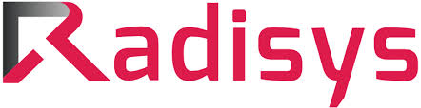

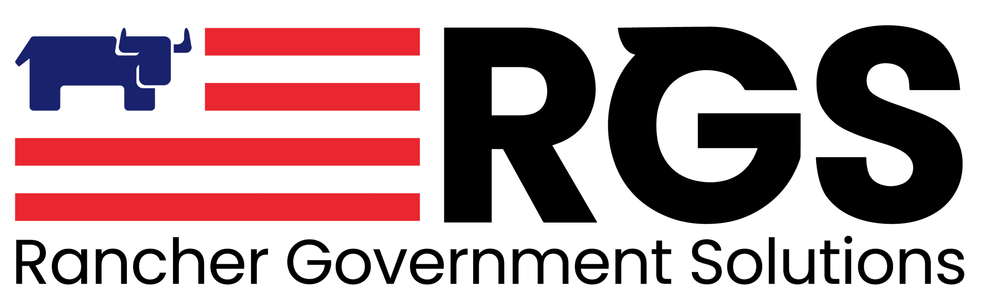

KTOS Introduction
Segment Overview
Kratos Defense and Security Solutions Company Overview
Kratos provides mission-critical technologies and services and continues to grow within the industry through strategic partnerships
Company Snapshot
Business Segmentation
Kratos Defense & Security Solutions (NASDAQ: KTOS) is a leading provider of advanced defense technologies, focusing on cybersecurity, critical infrastructure protection, and unmanned systems for government and commercial sectors
Headquartered in San Diego, California, and employs ~3,900 people full-time
Kratos Government Solutions (KGS)
Comprised of microwave electronic products, space, satellite and cyber, training solutions, C5ISR/modular systems, turbine technologies, and defense and rocket support services operating segments
Unmanned Systems (UxS)
Consists of unmanned aerial, unmanned ground, unmanned seaborne and related command, control and communications system businesses
Management Spotlight
Eric DeMarco, CEO, 2004 – Present
Under his leadership, KTOS shifted from a commercial communications business to a leading national security technology provider for the U.S. and its allies through strategic acquisitions
Deanna Lund, Executive VP & CFO, 2009-Present
She oversees KTOS accounting, financial reporting, and budgeting, and plays a central role in its divestitures and acquisitions
Business Segmentation as a Percentage of FY2023 Revenue
Revenue Growth ($MM)
Strategic Partnerships
UxS CAGR: 8.1% | KGS CAGR: 9.3%
Developing cloud native 5G-NTN solutions for satellite connectivity
Applying Shield AI’s Hivemind onboard UASs
Enable customers to deploy and scale virtual ground systems using KTOS’ OpenSpace software
Creation of a mentor protégé program, Atreus Technologies, LLC
Sources: CapIQ, Company Filings
Notes:
Kratos is very active in the M&A.
Strong revenue growth. Not so much in the UxS segment

Slide 21
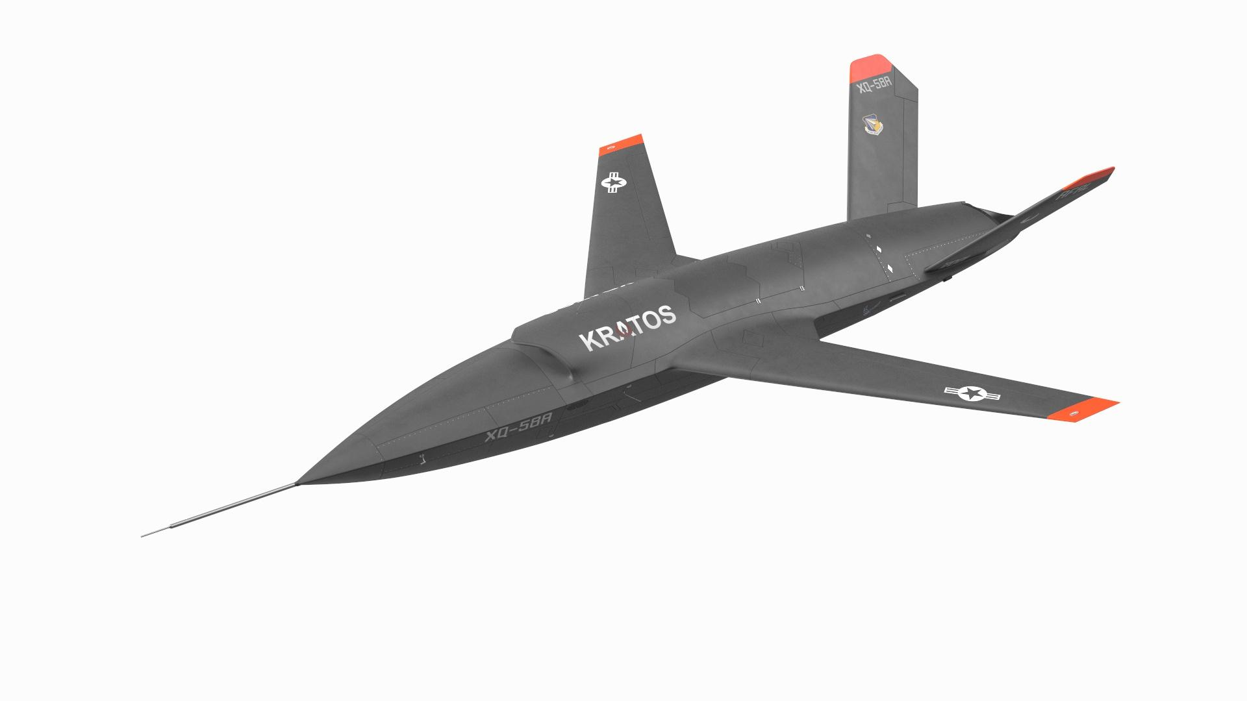
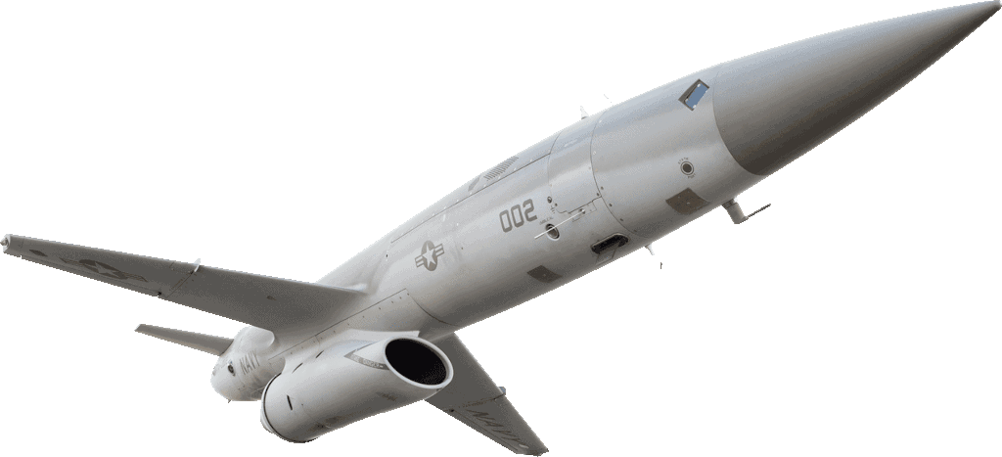
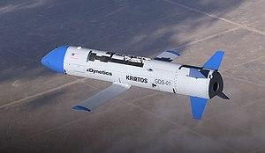
KTOS Introduction
Segment Overview
Kratos’ Unmanned Segment
Due to their scale advantage and vertical in medium-sized UAVS, Kratos’ UxS division offers multiple synergies in an AVAV acquisition
General Overview
Revenue ($MM) Profile
Three key offerings: the XQ-58A Valkyrie, UTAP-22 Mako UAV, X-61A Gremlin
Specializes specifically in medium-sized UAVs
Counter-positioned against Northrop Grumman and Lockheed Martin in their scale advantage over absolute quality, which is evident through the Valkyrie’s potential
Emphasis on autonomy, artificial intelligence, and low-cost production
Constitutes ~22% of their total revenues
Product Offerings
XQ-58A Valkyrie
UTAP-22 Mako UAV
X-61A Gremlin
Changing the paradigm of UAS technology through scale; designed for the LCAAT portfolio. AI equipped, medium-sized, highly maneuverable with mission equipped systems
Ample payload capacity in a low-cost system, the UTAP-22 offers rocket-assisted launch technology and precision parachute recovery. Kratos’ key player in the small, tactical space
Important strategic effort for DARPA, the Gremlin, which was the result of a joint project with Dynetics, is used for airborne launch and recovery of UAS from large aircraft
Source: Company Website

Slide 22
V. KTOS Valuation

Slide 23
KTOS Projections
KTOS Valuation
Description of KTOS UMS Financial Forecasts
Segment Projection
Given Information
Overview
Projections of FCF within KTOS’ unmanned systems segment to find suggested pricing
Revenue type and amount in the segment
Depreciation Expense
Operating Income
Revenue
Service revenues will grow at a negligible rate
Product Revenues grow like historic average as and attempt to give conservative outlook
Method
Take a line items proportion of total revenue and multiply by revenue in the segment to estimate what the item would be within the segment
Gross Margin
Remains constant at 56% given management expressed cost of sales remain fairly stable as a percent of revenue
“Catch-all” Explained
Expenses
Expenses were kept in line with historicals
Besides R&D expenses are unlikely grow as a percentage of revenue
Necessary balance to get from estimated expenses to reported operating income
Accounts for restructuring and one-off expenses
Operating Margin
Operating margin scales as charges associated with items like restructuring decrease over time
Simplifying Assumption
AV
Exit multiple of 10x AV/EBITDA (derived from comparable companies) leads us to a sensitized AV between $180 and $324
Line items and expenses are constant as a proportion of revenue across Kratos’ different segments
Source: S&P Capital IQ

Slide 24
KTOS Projections
KTOS Valuation
KTOS UMS DCF – Management Case – Exit Multiple Method
 | 2024E | 2025E | 2026E | 2027E | 2028E | 2029E | 2030E
Revenue | 227 | 243 | 263 | 285 | 306 | 327 | 348
% Growth | 15.2% | 17.2% | 18.4% | 18.9% | 19.7% | 19.5% | –
(-) Operating Expenses | (221) | (238) | (255) | (274) | (289) | (299) | (319)
(+) Depreciation & Amortization | 10 | 10 | 11 | 12 | 13 | 14 | 15
EBITDA | 16 | 16 | 19 | 22 | 29 | 42 | 44
% Margin | 7.0% | 6.6% | 7.3% | 7.9% | 9.6% | 12.8% | 12.5%
(-) Depreciation & Amortization | (10) | (10) | (11) | (12) | (13) | (14) | (15)
EBIT | 6 | 6 | 8 | 10 | 16 | 28 | 29
% Margin | 2.7% | 2.3% | 3.0% | 3.6% | 5.3% | 8.5% | 8.2%
(-) Unlevered Taxes | (1) | (1) | (2) | (2) | (3) | (6) | (6)
NOPAT | 5 | 5 | 6 | 8 | 13 | 22 | 23
(+) Depreciation & Amortization | 10 | 10 | 11 | 12 | 13 | 14 | 15
(-) Capital Expenditures | (11) | (12) | (13) | (14) | (15) | (16) | (17)
(-) Change in Net Working Capital | (12) | (4) | (5) | (5) | (5) | (5) | (5)
Unlevered Free Cash Flow | (9) | (1) | (0) | 1 | 6 | 15 | 15
(-) Stub-Year
FCF For Discounting | (9) | (1) | (0) | 1 | 6 | 15 | 15
Key Assumptions:
Valuation Date: November 11, 2024
Effective Tax Rate: 21.0%
WACC range of 8.8% - 10.6%
Terminal value based on exit multiple method (7.0x and 13.0x)
Final projection year: April 30, 2030
No adjustments for midyear convention
Exit Multiple |  | 7.00x |  |  | 13.00x
Discount Rate | 8.8% | 9.7% | 10.6% | 8.8% | 9.7% | 10.6%
Present Value:
Forecasted Free Cash Flow | 12 | 11 | 10 | 12 | 11 | 10
Terminal Value | 177 | 169 | 160 | 329 | 313 | 298
Aggregate Value | 190 | 180 | 171 | 342 | 324 | 308

Slide 25
KTOS Projections
KTOS Valuation
KTOS UMS Acquisition Valuation Matrix
 | AV/EBITDA |  | 40% Cash / 60% Stock |  |  |  |  | Return Metrics
Aggregate Value | CY24E | CY25E | Equity Consideration | Cash Consideration | PF Net Leverage | AVAV / KTOS PF Ownership | Year 5 ROIC |  | Year 2 EPS Accretion (2026E)
METRIC: | 15.8 | 16.2 |  |  | 115.8 |  | 22.0
$158 | 10.0x | 9.8x | 94.92 | 63.28 | 1.3x | 98% / 2% | 13.9% |  | 2.46%
$168 | 10.6x | 10.4x | 100.92 | 67.28 | 1.3x | 98% / 2% | 13.1% |  | 2.35%
$178 | 11.3x | 11.0x | 106.92 | 71.28 | 1.3x | 98% / 2% | 12.3% |  | 2.24%
$188 | 11.9x | 11.6x | 112.92 | 75.28 | 1.4x | 98% / 2% | 11.7% |  | 2.13%
$198 | 12.5x | 12.2x | 118.92 | 79.28 | 1.4x | 98% / 2% | 11.1% |  | 2.03%
$208 | 13.2x | 12.9x | 124.92 | 83.28 | 1.4x | 98% / 2% | 10.6% |  | 1.92%
$218 | 13.8x | 13.5x | 130.92 | 87.28 | 1.4x | 98% / 2% | 10.1% |  | 1.81%

Slide 26
VI. Investment Proposal: Carve Out of KTOS Unmanned Systems Segment

Slide 27
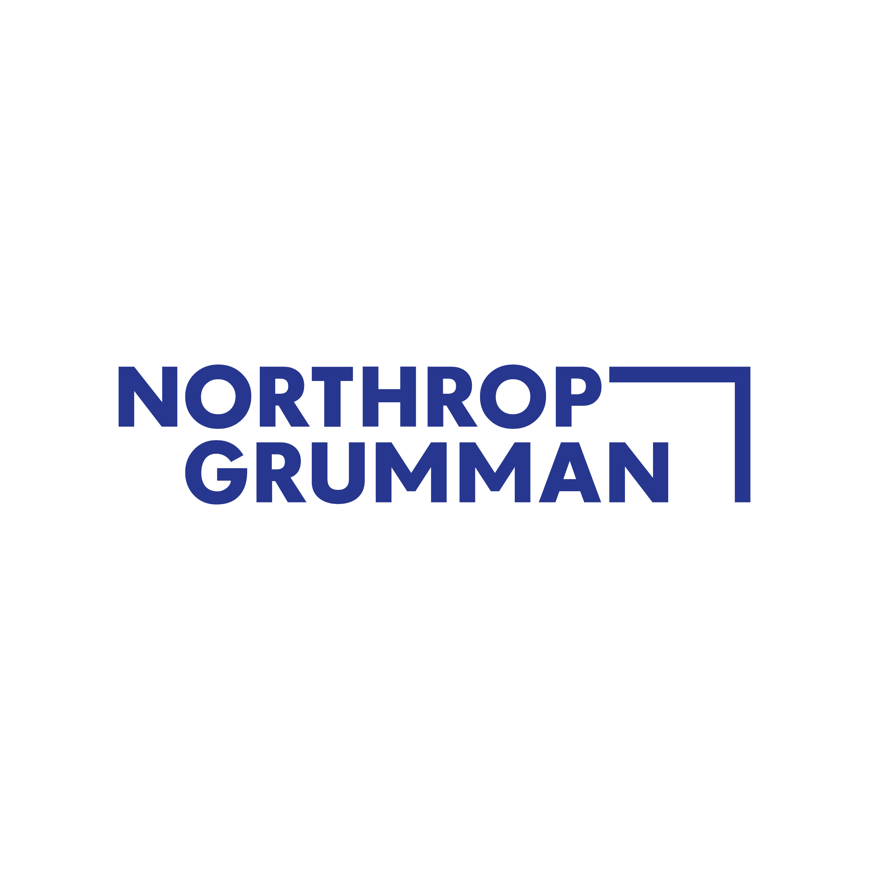
KTOS Perspective
Strategic Compatibility
Kratos: Why Now?
KTOS’ declining sales, the companies’ previous collaborations, and recent consolidation lead to KTOS’ current positioning to sell to AVAV
1
2
3
Declining Unmanned Systems Sales
The Kratos unmanned systems segment consists of tactical UAVs and aerial target drones
This segment would give AVAV access to additional aerial drone technology that AVAV could incorporate with their existing LMS and UxS product offerings
Product revenue declined by 5% from 2022 to 2023 after declining by 4% the previous year which could incentivize Kratos to sell to AVAV
Previous Collaborations Demonstrate Potential for Crossover
In May 2019, AeroVironment collaborated with Kratos to incorporate AVAV’s tube-launched missile capabilities with Kratos’ larger unmanned drone systems
In September 2021, Kratos demonstrated its Airwolf unmanned aircraft to air-launch an AVAV Switchblade loitering munition
These collaborations can increase both companies appeal for future defense contracts
Consolidation in the Defense Industry
The defense industry has seen considerable consolidation in recent years through M&A among defense contractors leading to fewer large firms dominating the market
This consolidation has made it more difficult for smaller players like Kratos to secure Department of Defense contracts as the DoD tends to favor larger, established firms who can invest heavily in R&D
Timeline of Kratos and AeroVironment Collaborations
UMS Product Sales ($MM)
2023 Top DoD Contractors($MM)
AVAV launches Switchblade
AVAV and Kratos reveal integrated unmanned system solutions
2015
2021
2012
2019
Kratos develops its Mako Tactical UAS
Kratos demonstrates its Airwolf launching an AVAV Switchblade
Sources: CapIQ, Company Websites, Statista

Slide 28
KTOS Perspective
Strategic Compatibility
Acquisition Rationale
1
Complementary Product Offerings
AVAV and KTOS’ offerings possess inherent combinative features
Product integration between AVAV’s smaller products and KTOS’ larger UAS demonstrate the potential for a more cohesive product offerings and enhanced total services
2
New Market Penetration
Introduction into niche offerings
Kratos and AeroVironment have product specialties that would introduce advantages to both companies in an acquisition
KTOS: counter UAS, Land & Sea unmanned systems, medium UAVs
AVAV: small UAVs, specialty in LMS
3
Synergized R&D
Continual investment opportunities
Kratos and AeroVironment have different R&D strategies: KTOS prides itself on low cost and scalability while AVAV innovates through high expenditures
Therefore, they could cut costs without sacrificing quality of innovation
4
Alignment of Strategic Visions
Transaction presents and opportunity for mutual enhanced focus
Purchasing the unmanned systems segment allows for both companies to follow their expressed strategies for future growth
Notes:
Change smart art to one steve has

Slide 29
KTOS Perspective
Strategic Compatibility
Distinct Products, Shared Value
Despite specializing in separate products and services, chance for combination exists
1
Product and System Potential Integration
Possibilities for combination of AVAV’s smaller unmanned systems and KTOS’ larger autonomous systems to increase range of services available to customers
Product Integration
Increasing Product Complexity
Improvements in contract bid rates
Kratos offers a much more complete array of services to their customers in the UAS segment
Many of these services such as, payload solutions, ground support equipment, recovery systems, and many more could be used to make AVAV’s products look more enticing
Scaling R&D capabilities
System Applications
Sources: Company Filings and Press Releases
Notes:
Think about pairing ugv’s with atma (road clearing capabilities – then can drop these surveillance drones in new areas)

Slide 30

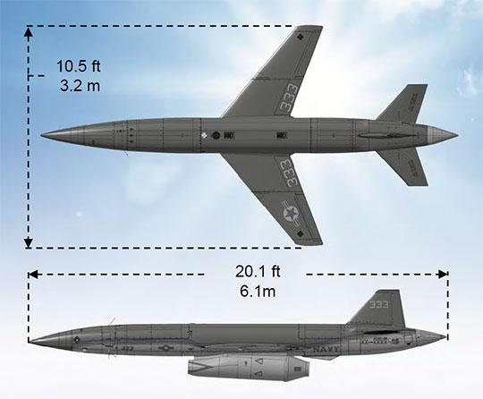
KTOS Perspective
Strategic Compatibility
Previous Collaboration
Collaboration between AeroVironment and Kratos in 2019 demonstrates the potential for increased product integration
1
Integration Case Study
AeroVironment’s Switchblade
Demonstrated Integration
Kratos’ UTAP-22 Mako
In 2019, a strategic relationship to develop integrated multi-domain unmanned systems was announced
The goal was to use AVAV’s missile capabilities and Kratos’ host aircraft capabilities to deliver a more consolidated total offering
Product Details
Takeaway
Product Details
“Tube-launched, rapidly deployable and highly maneuverable armed UAV with high-performance optics and scalable munition payloads. Switchblade products enable warfighters to easily launch, track and engage beyond-line-of-sight targets, including light armored vehicles, across contested domains.”
Targets a key avenue that AVAV is focused on for sustained growth
Integration with existing platforms easier given access to Kratos’ larger unmanned systems
Early attempt at collaboration demonstrates the potential for product synergies
Fighter-like aircraft with capabilities of operating along manned fighter jets as a partner/wingman. Designed for various arrays of internal and external payloads. Rocket-assisted launch and parachute recovery facilitates independence unlike other offerings that rely on the X-61A Gremlin for launch and retrieval.
Sources: Company Filings and Press Releases

Slide 31
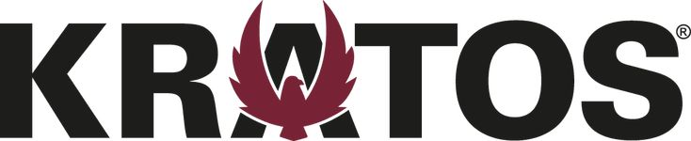
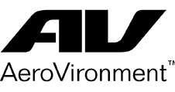
KTOS Perspective
Strategic Compatibility
New Opportunities to Thrive
Kratos and AeroVironment both have unique specialities that would enhance both AVAV and KTOS’ position in the defense sector
2
Expansion into Untapped Markets
Product Area |  |  | Analysis
Small UMS | Low | High | AeroVironment has a clear specialty in small UAS, as evident by products such as the Puma, P-550, and Raven B. Meanwhile, Kratos has little to no exposure in this category, making an acquisition advantageous given market trends toward sUAS
Medium UMS | High | Low | While AeroVironment has the JUMP 20 and T-20 in its mUAV segment, it would benefit from acquiring Kratos due to their advantage in mUAVs evidenced by the Valkyrie. This would also spur more integration with the emerging LMS segment
Counter UAS Systems | Medium | N/A | AVAV has no presence in cUAS, which involves detection radars, RF sensors, and disruptive technologies to patrol enemy drones. In January, KTOS was awarded a $50 MM contract for cUAS, air defense, and radar systems
Ground & Sea UMS | High | Medium | Primarily, AVAV’s UGVs are used to disable bombs, which has awarded them some small contracts; however, Kratos has additional offerings such as its autonomous truck (ATMA) and even sea surface vehicle automation
Loitering Munitions | Low | High | Some categorize Kratos’ Gremlin as an LMS, but outside of that, Kratos has little exposure to this rapidly growing business segment. Meanwhile, AVAV is a leader in the space and could integrate KTOS’ AI and swarm tech solutions
Sources: Company Filings and Press Releases

Slide 32
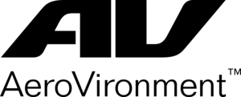
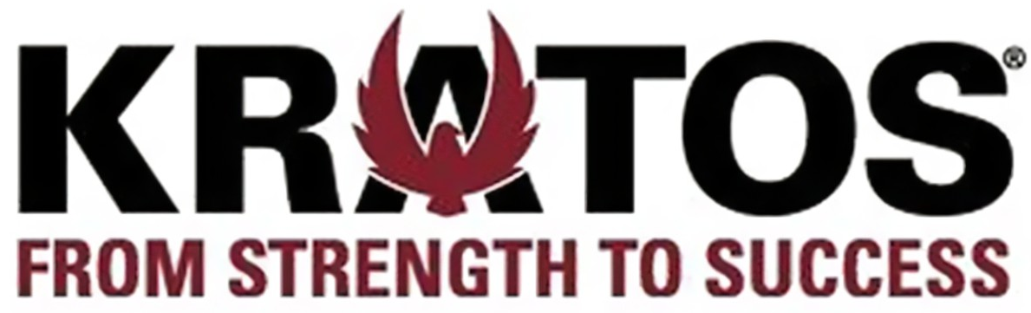
KTOS Perspective
Strategic Compatibility
Primed to Innovate
AVAV and KTOS have differentiated innovation strategies, and bringing them together would introduce synergies to both parties
3
Capacity of Innovation Through R&D
AeroVironment has a unique strategy compared to large competitors in the space. Rather than researching as potential contracts are released, they innovate in advance to win early contracts
In 2024A, R&D as a % of revenue was ~13.5%
Historical advantage in innovation exemplified by the HAPS solar-powered pseudo-satellite, Mars Ingenuity Helicopter, and Nano Hummingbird, which is capable of precise hovering and omni-direction flight
Growth opportunities: AI, Space Robotics, Data Analytics, Long range ISR
Rather than spending vast amounts of money into R&D, Kratos innovates at scale and prides itself as a low-cost contractor, leading to efficient spending
As a whole, LTM R&D as a % of revenue was only ~3.5%
Since 2012, they have spent $230 MM into UMS and were awarded innovative contracts involving jet drone research, sensor integration, and prototype air vehicles
Growth opportunities: Microwave electronics, Hypersonic Systems, Data Analytics, AI
AeroVironment’s commitment to innovation through high expenditures and Kratos’ ability to research and develop at a low cost could help AVAV reduce expenses without sacrificing any quality of new products
Shared growth opportunities: Kratos and AVAV have a history of partnering, and could certainly help each other capitalize on shared industry trends
AeroVironment post-acquisition
Sources: Company Filings and Press Releases

Slide 33
KTOS Perspective
Strategic Compatibility
Alignment Empowered by Exchange
This proposition would help both parties align with their strategic initiatives
4
Strategic Visions Align
AVAV Strategic Avenues
KTOS Strategic Avenues
Target companies within the Uncrewed systems market that broaden portfolio capabilities within existing and adjacent markets
Integration with existing platforms (tanks, trucks, aircraft, and ships) to expand product reach and usefulness
Remain competitive in acquiring DOD programs within LMS, and UxS
Release “first to market” offerings by investing in primary business areas such as unmanned systems, space and satellite communications, cybersecurity, etc.
Focus on obtaining “a large part of something” and expanding within areas with a strong customer base and contract win history
Acquiring the unmanned segment is aligned with AVAV’s current strategic acquisition strategy
It presents opportunities for integration with KTOS’ larger existing platforms
It helps AVAV remain competitive for DoD bids through access to a greater arsenal of technology and increased R&D capabilities
Divesting the unmanned systems segment would allow Kratos to become more singularly focused and improve speed of product innovation
A more defined focus would allow for a shift towards sectors where contract awards are much higher and can support significant R&D expenses to achieve growth necessary to scale in the defense industry
This acquisition allows for both AVAV, and KTOS to further align themselves with stated strategic visions moving forward
Sources: Company Filings and Press Releases
Notes:
Etc. , microwave electronics, hypersonic and rocket systems, missile defense, jet engines, rocket motors and turbine technologies, and training systems
Weakness is kratos has expressed desire for contract diversity

Slide 34
VII. Acquisition Highlights & Synergy Realization

Slide 35
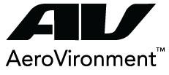
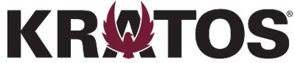
Acquisition Highlights
Acquisition Proposal
Key Investment Highlights
An acquisition of Kratos will diversify AVAV’s product offerings, increase its ability to innovate through R&D, and lead to several cost-based and revenue synergies
Diversification and Integration
Cost-based synergies
Kratos’ specialty in manufacturing low cost, medium-siized UAVs will expand AVAV’s presence in the unmanned sector
Larger UAVs could be a host platform for AVAV’s fastest growing LMS business segment
Kratos was recently awarded a $50 MM contract for its new counter UAS offerings and also has autonomous trucks and sea vehicles, offering AVAV upside through diversification
In our base case, we assumed synergies of 4-5% for SG&A due to possible logistical and geographic consolidation in Southern CA
Also in our base case, we assumed COGS synergies of 4-6% due to saved costs with key inputs technology
Across all cases, we also included minimal revenue synergies due to shared knowledge giving AVAV a higher chance of winning contracts
Innovation Prospects
R&D Advantages
Accretive to EPS
Kratos has prioritized innovation of its UxS segment through swarm technology, which has yet to be seen in AVAV’s products
Kratos also offers strong C5ISR solutions (Command, Control, Communications, Computers, Combat Systems, Intelligence, Surveillance, Reconnaissance)
AVAV’s R&D as a % of revenue is ~2.5x greater than comparable contractors, and Kratos will contribute to its R&D advantage with its low cost solutions and scalability
Across all cases, R&D synergies were the greatest due to AVAV and KTOS’ advantage in research and saved cost through collaboration
Ultimately, we found the acquisition to be accretive to EPS with the % accretion growing every year to 2030E
2025E Accretion: 1.3%
2030E Accretion: 18.1%
The primary drivers of the accretion increase were due to cost savings, but we also found revenue synergies

Slide 36
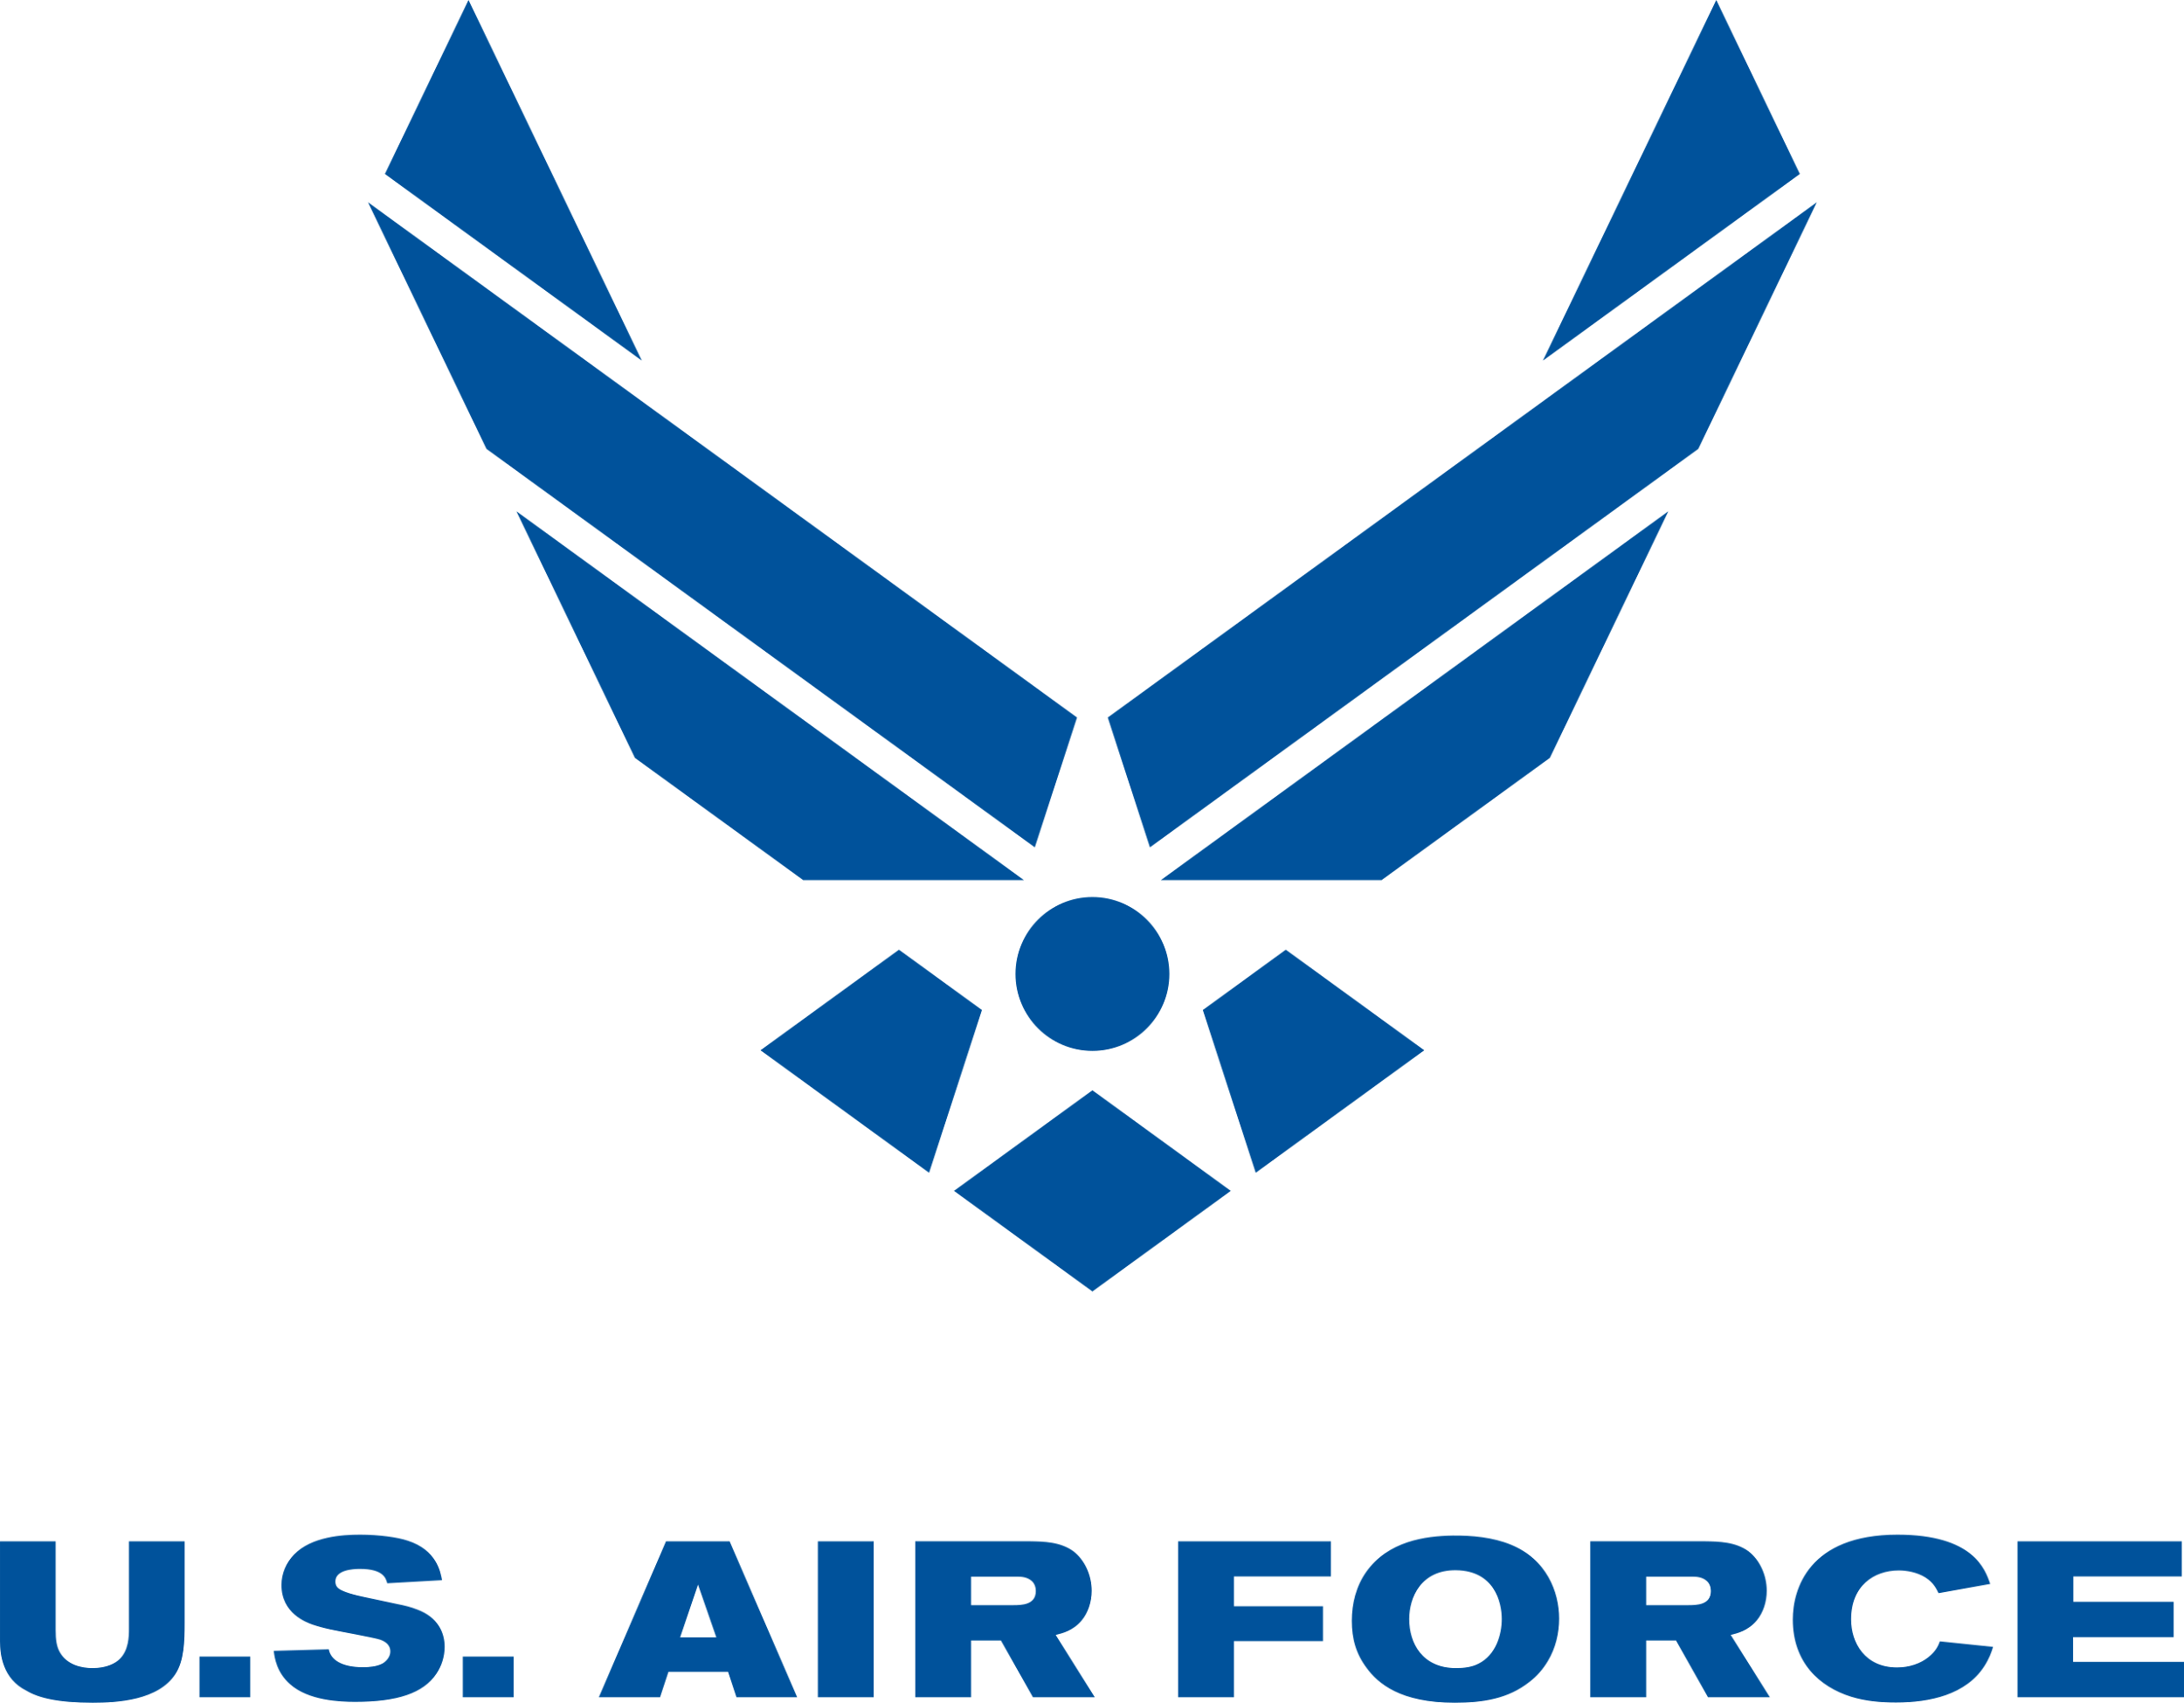

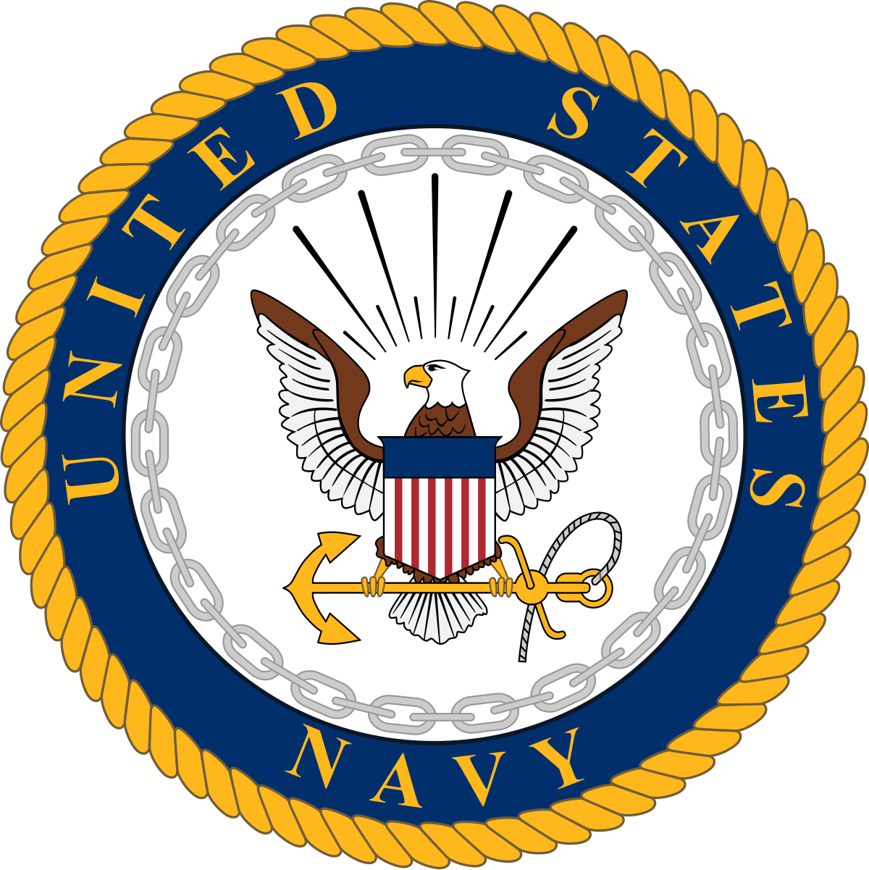

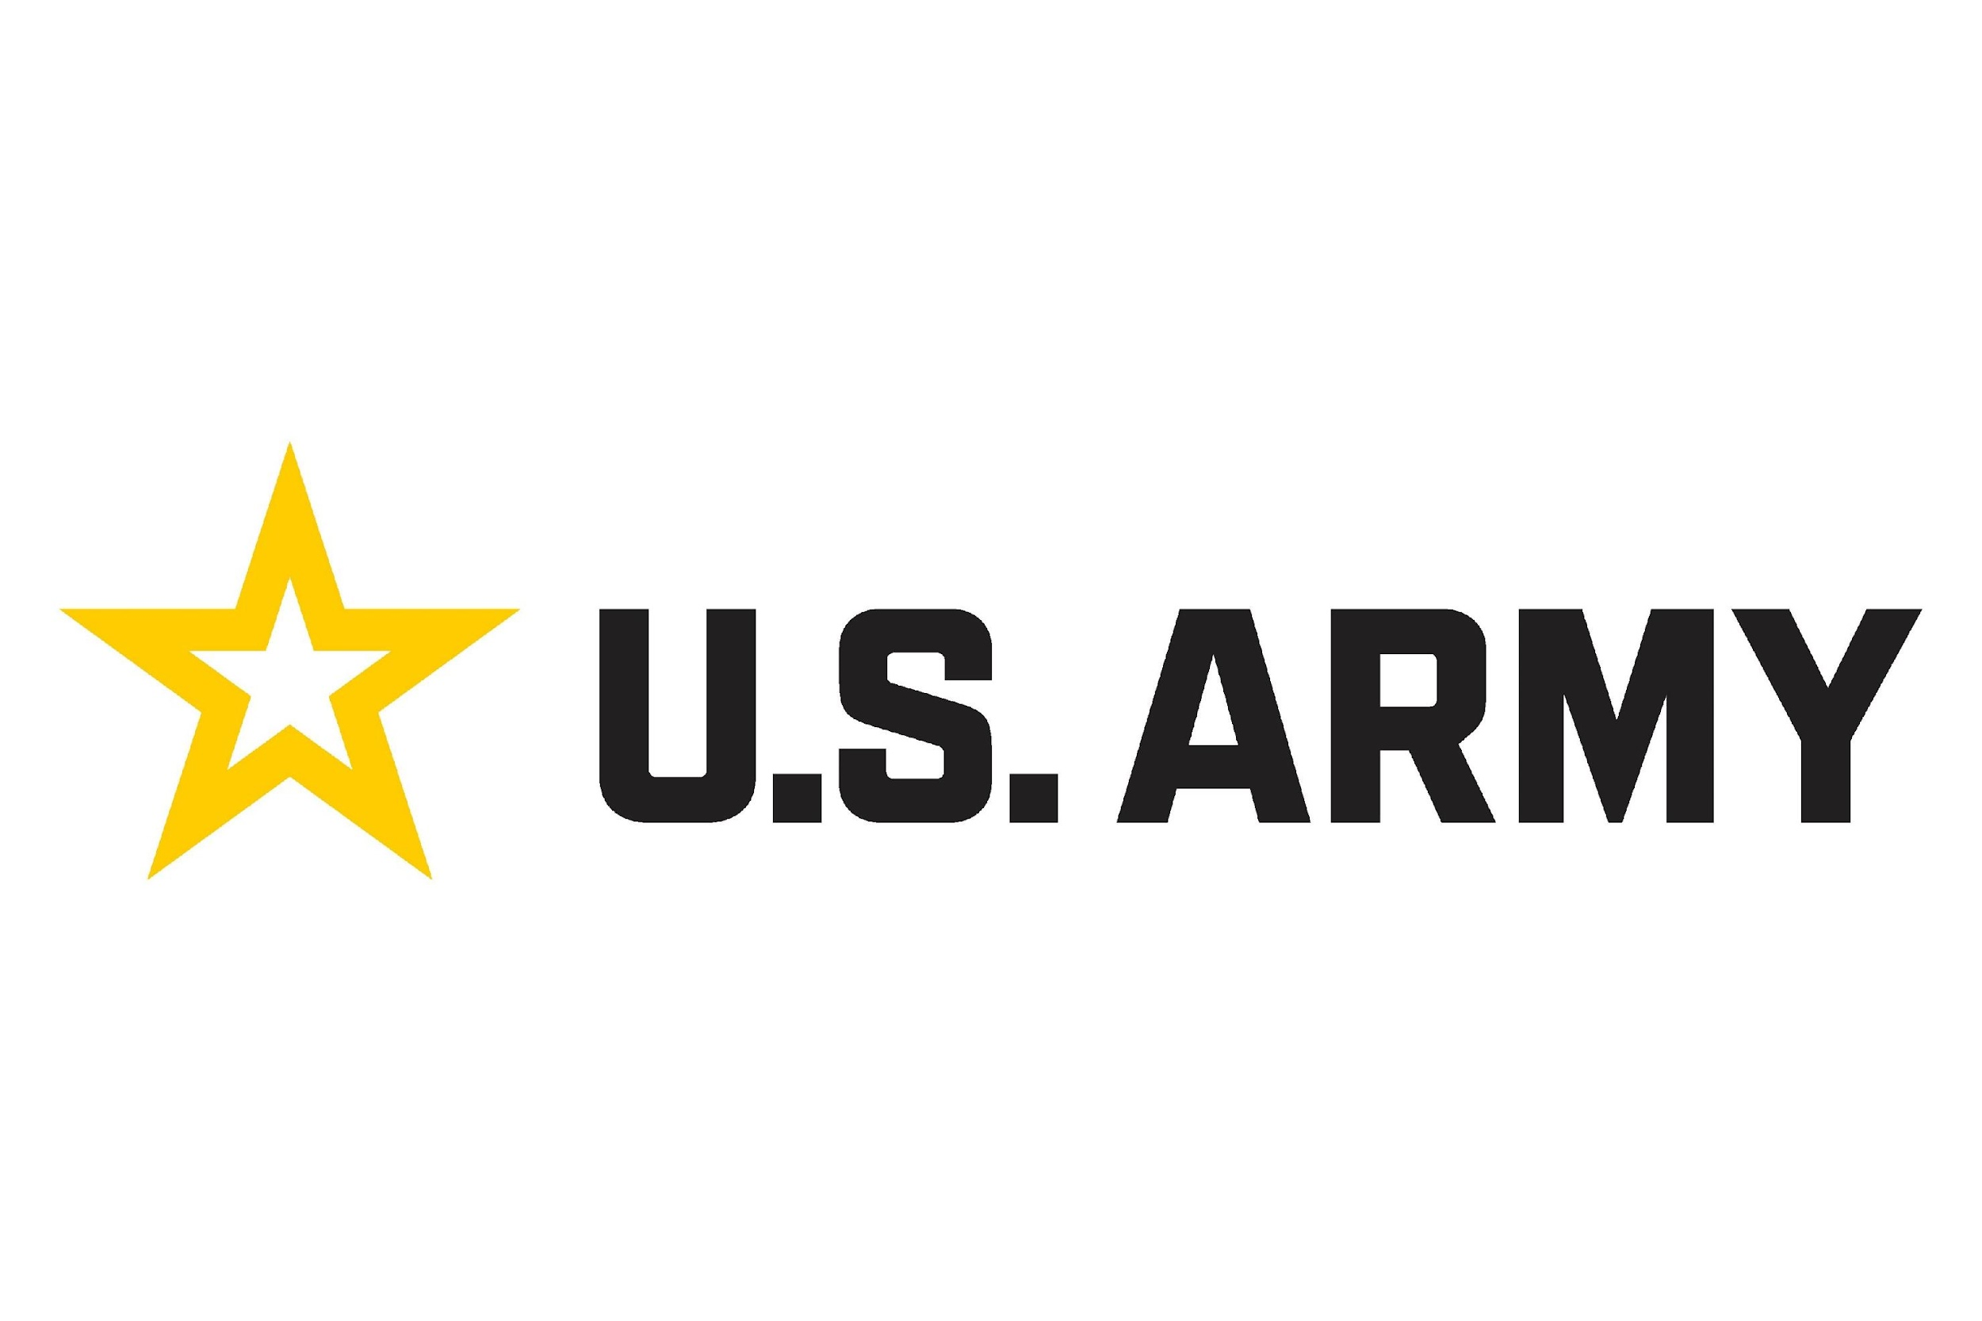
Acquisition Highlights
Acquisition Proposal
Concrete Synergy Realization
Multiple synergies, from supply chain and R&D costs to product complements and contractor expansion, can be capitalized on
Synergy Expectations
Cost Synergies
Revenue Synergies
Consolidating supply chains will reduce costs related to raw materials, components, or procurement
Joint R&D efforts will help avoid research duplication and pool development costs
Sharing costs of immense capital investments will reduce risks for large contracts and contract bidding
By leveraging relationships AeroVironment has with large contractors, Kratos products can complement existing products
Kratos’ specialization in high performance drones will complement capabilities of AeroVironment’s small tactical drones
Past Contractors
R&D as a Percentage of Revenue
Kratos
AeroVironment
Sources: CapIQ, Company Filings
Notes:
AeroVironment has contracts with several allied partners, including Lithuania, Romania, and Sweden. AeroVironment's small unmanned aircraft systems are also used by the armed forces of Italy, Denmark, the Netherlands, Spain, France, Norway, the Czech Republic, Thailand, and Australia. These relationships goes as far back as 2012. AVAV also has contracts with DoD.
Kratos primary customers include the United States Air Force, Navy, and Army.
I believe the ability for kratos products to become more global is something that should be emphasized

Slide 37
Acquisition Highlights
Acquisition Proposal
Overview of Proposal
Proposing that AeroVironment carve out Kratos’ Unmanned Systems segment in a 60% stock and 40% debt deal
Summary of Proposal
Transaction Summary
Key Terms
Description
Transaction Summary
 | Current |  | Final Proposal
 | 2024-11-25 |  | 2024-12-31
Share Price | $26.60 |  | $31.92
FDSO (MM) | 5.9 |  | 5.9
Fully Diluted Equity Value | $157 |  | $189
(+) Debt | 61 |  | 61
(-) Cash | 62 |  | 62
Fully Diluted Aggregate Value | $157 |  | $188
EBITDA (2024) Multiple | Metric
FY2024E Street Case | 6.5 | 24.1x |  | 28.9x
FY2024E Management Case | 6.1 | 25.7x |  | 30.8x
EBITDA (2025) Multiple | Metric
FY2025E Street Case | 6.0 | 26.1x |  | 31.4x
FY2025E Management Case | 5.7 | 27.5x |  | 33.0x
Implied Price Premium
Premium to Current | $26.60 |  |  | 20.0%
Premium to 30-Day Average | $24.81 |  |  | 28.7%
Premium to 90-Day Average | $23.92 |  |  | 33.4%
Premium to LTM High | $27.73 |  |  | 15.1%
Premium to 1-Year Average | $20.63 |  |  | 54.7%
Price
Implied share price of $31.92, representing a 20% premium to current share price
Exchange ratio of 0.16
Representing an AV of $188.9 mm (KTOS UMS) and $5,986.0 mm (AVAV)
Forms of Consideration
60% stock and 40% debt
Financing
Assumed that AVAV has delivered to KTOS a copy of the commitment letter by and among the financing sources
Certain Conditions to Close
Stockholder approval shall be obtained by a vote of Kratos
Regulatory approval
The form S-4 to be declared effective by the SEC
Absence of a Material Adverse Event
Termination Fee
2% of aggregate equity value to be paid
Announcement Timing
Expected closing Q1 2025

Slide 38
Acquisition Highlights
Acquisition Proposal
KTOS/AVAV Accretion
Key Assumptions:
Accretion Percentage
Assumes revenue synergies with a CAGR of 27.4% through increased product bundling
COGS synergies were assumed to have a CAGR of 13.8% because of expected economies of scale and the elimination of overlapping manufacturing processes
Expected consolidated R&D expenses led to an assumption with a CAGR of 11.5% for R&D synergies
Assumes a CAGR of 8.27% for SG&A synergies due to consolidated relationship management with the government
Pro Forma Combined EPS ($MM)
2025E-2030E EPS CAGR: 14.1%

Slide 39
VIII. Appendix A: AVAV Supporting Materials

Slide 40
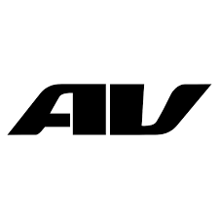
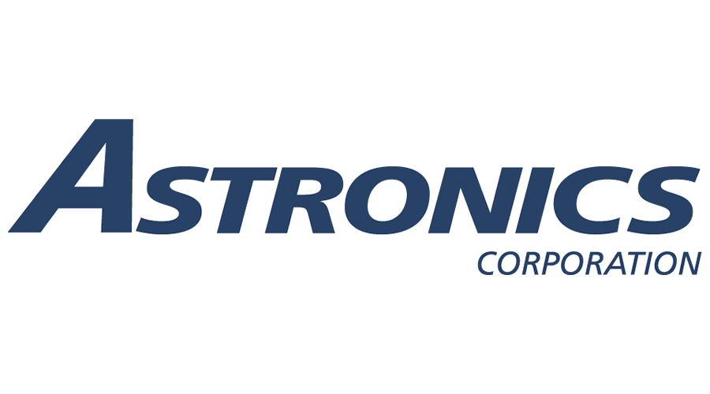
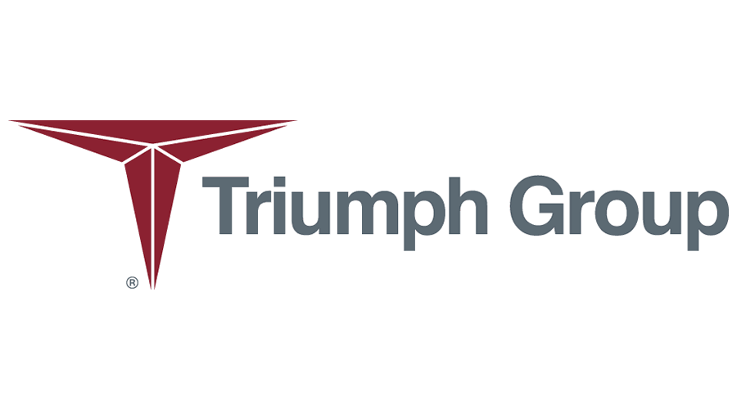
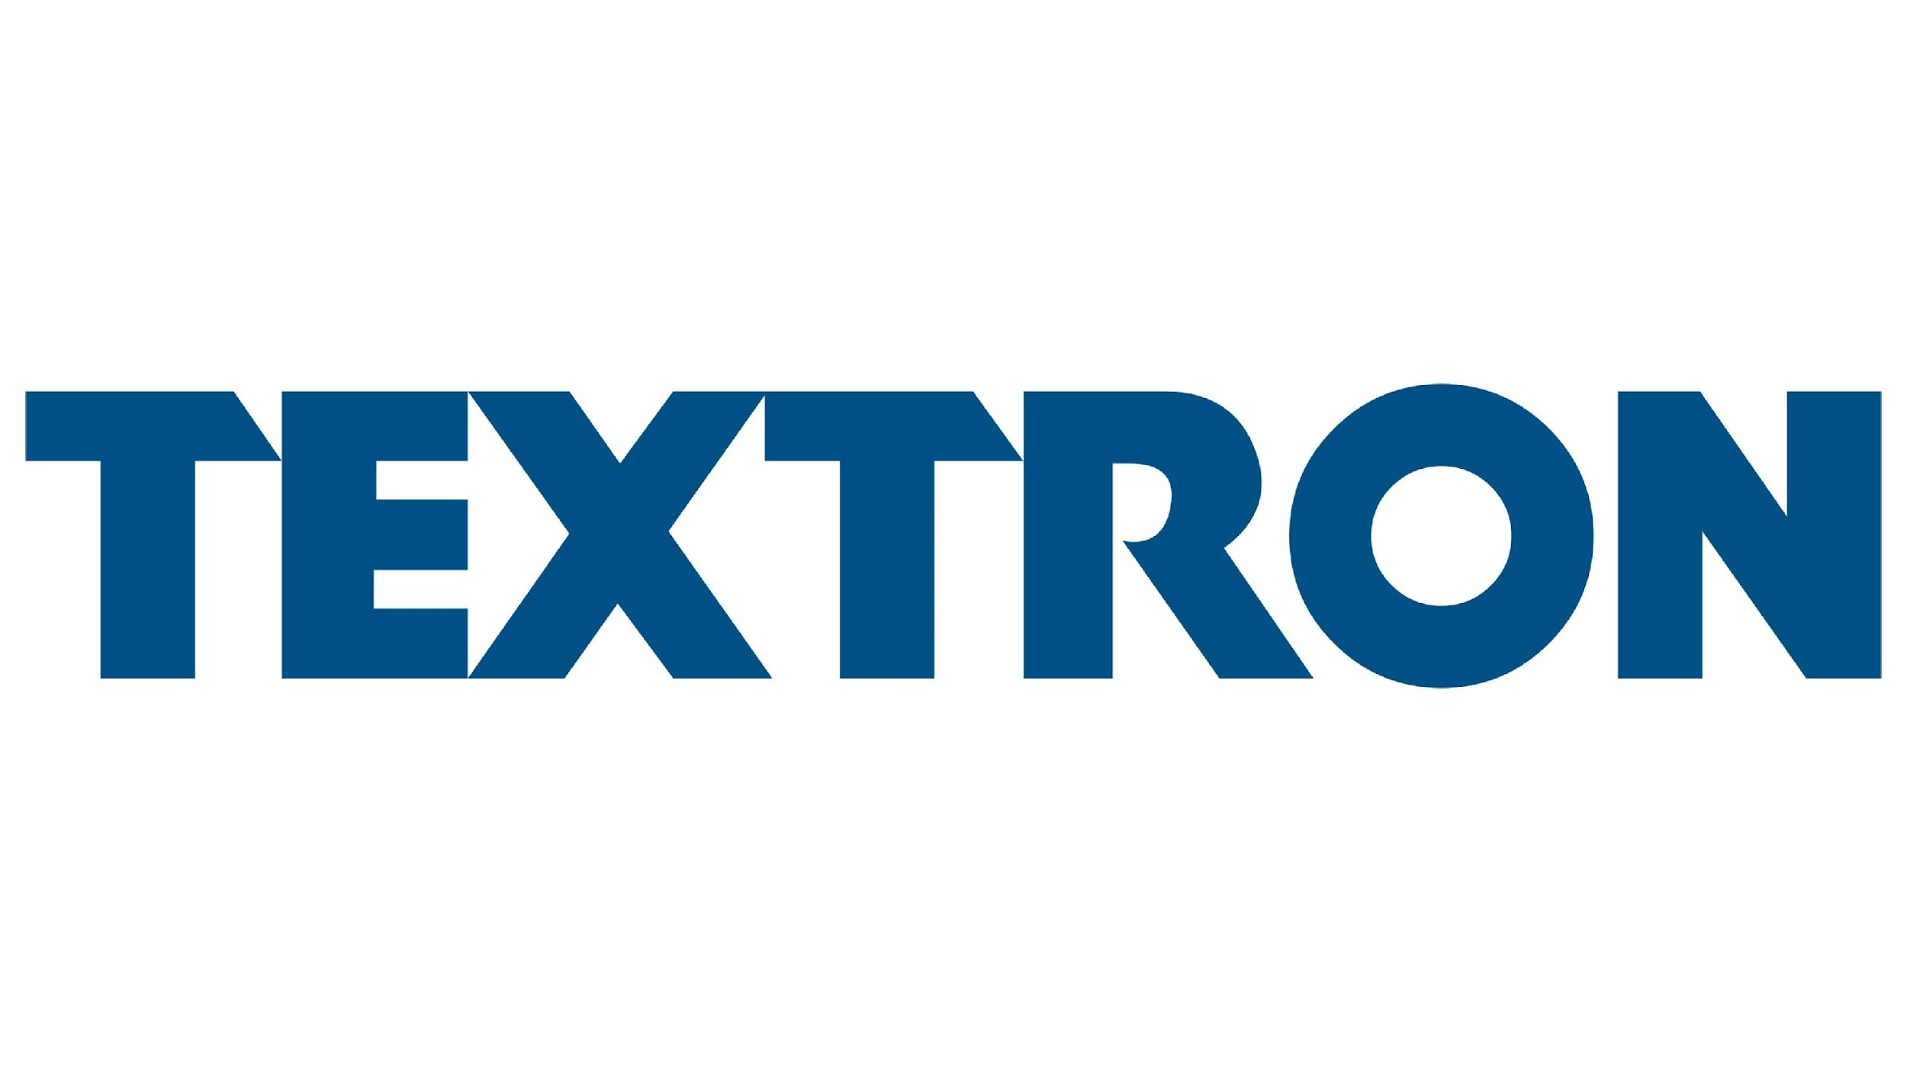
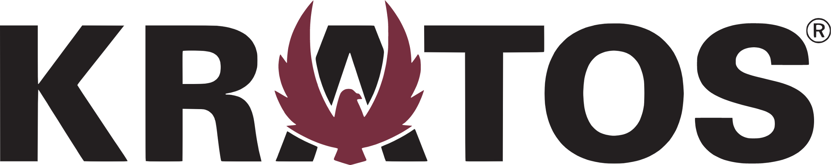




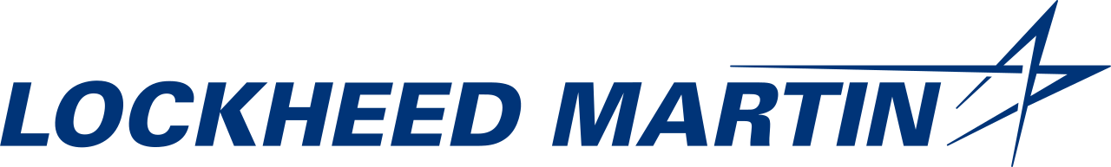
Comparable Operating Metric Benchmarking
EBITDA Margin (%)
2023 Median: 11.9%
2024 Median: 11.3%
Gross Margin (%)
2023 Median: 22.9%
2024 Median: 21.6%
Source: CapIQ
‹#›

Slide 41
Comparable Operating Metric Benchmarking
R&D as a % of Revenue
Capital Expenditure as a % of Revenue
Source: CapIQ
‹#›

Slide 42
Comparable Multiples Metric Benchmarking
AV/EBITDA LTM
2023 Median: 15.8x
2024 Median: 15.1x
NTM Forward P/E
2023 Median: 18.7x
2024 Median: 18.7x
Source: CapIQ

Slide 43
Industry Multiple Evolution
Due to its unique product offerings, the market is confident in AVAV’s ability to generate revenue and EBITDA in the future
AV/Forward Revenue (3 yr)
AV/Forward EBITDA (3 yr)
Source: S&P Capital IQ

Slide 44







Precedent Transactions
Ample opportunity exists for companies to consolidate and extend their reach into pre-existing markets
AV/EBITDA
Transaction Price ($MM)
$4684
$173
$731
$106
Median: 16.9x
Attempt to keep up with high demand for missiles and rocket motors
Added expertise in missile defense systems and hypersonics
Voluntary takeover resulting from undervaluation of space stocks
Potential for expedited growth as a private company
25.1% stake acquired to extend reach over European Defense Electronics market
Allowed Leonardo to further expand into sensors and robotics
Desire to employ growth strategies in aerostructure market
Demonstrates necessary size required in A&D industry to build profitable relationships
Sources: CapIQ, Factset, Sec Filings, Company Press Releases, DefenseNews, SPACENEWS

Slide 45











Comparable Transactions Rationale
Desires to grow, have access to new technology, and offer a wider range of services fuel transactions
$27
Sierra served as an option for Kratos to strengthen their ariel target business offerings
Targeted for 5GAT platform and success within unmanned system services
$40
Increase satellite payload production and communication capabilities
Access to SatixFy’s digital payload chip technologies that are required for advanced digital satellite payloads
$77
Wider range of services and production possibilities in flight-control sector and integrated avionic systems
Desire for a long-term parent company to support growth
$155
Attempt to meet growing demand for digitally converged solutions
Provides Mercury with offerings of visual smart displays to broaden mission processing capabilities
$163
Potential for Hexcel to deliver the next generation of aerospace materials is heightened by acquiring a leading manufacturer of RF/EMI and microwave absorbing composite materials
Sources: CapIQ, FlightGlobal, DEFENSE DAILY, Company Statements

Slide 46
Analyst Sentiment for AeroVironment
AVAV’s rising stock price reflects strong government contracts, a large funded backlog, and a technological edge
$216.0
+127.9%
Current Coverage
Comments
Analyst | Jefferies | RBC Capital | BTIG | Baird | Alembic Global Advisory
Target Price | $240 | $240 | $245 | $220 | $225
In August, AeroVironment was awarded a $54.9 MM delivery order for Switchblade® loitering munition systems as part of a larger contract with the U.S. Army which has a ceiling value of $990 MM
A rare quick resolution to a stop work order on the contract with the Army indicates growing dependence on AVAV’s technologies
The most recent quarterly filing revealed $372.9 MM in funded backlog providing revenue visibility and confidence in contract flows
The JUMP 20® uncrewed aircraft system recently enforced AVAV’s technological capabilities at REMPUS, an annual NATO exercise
Risk: Potential production issues or supply chain disruptions could prevent AeroVironment from converting backlog into revenue as expected and damage the company’s reliability
Average Target Price | Potential Return on Average Price
$234 | 8.5%
1
6
6
1
Sources: Bloomberg, CapIQ, Jefferies Equity Research Report, BTIG Equity Research Report, Company Materials

Slide 47

AVAV Benchmarked Share Price Outperformance
Over the past 5 years, AVAV’s share price has experienced significant appreciation
Stock Chart (5 yr)
Segment Comparable Analysis
 | LTM Total Revenue | LTM EBITDA | LTM Gross Margin % | LTM EBITDA Margin % | LTM Total Debt/EBITDA | 5-yr Beta
SUAS Comps | $5,929.60 | $955.30 | 33.8% | 16.6% | 2.2x | 0.45
MUAS Comps | $35,348.40 | $2,470.10 | 19.5% | 9.8% | 10.6x | 0.63
UGV Comps | $13,158.40 | $2,514.00 | 34.8% | 21.0% | 2.8x | 0.87
 | $753.90 | $108.10 | 39.8% | 14.3% | 0.4x | 0.50
Sources: S&P Capital IQ

Slide 48
AVAV Annotated AV / NTM EBITDA
Increases in military budgets have led to a significant rise in demand for AVAV’s UAVs
Nov-03-2024,
25.4x
Revenue Growth
AVAV Product Demand
Innovations
AVAV expects double digit revenue growth for FY 2025
They’ve set a precedence for revenue growth validating future growth
AVAV predicts increase demand in their LMS product line as reflected in 60% sales growth in 2024
UxS revenue grew by 30% with heightened demand for PUMA and JUMP 20 systems
MacReady Works is heavily involved in developing next gen solutions for the US DoD
Successes with the Ingenuity Mars Helicopter is only the start of breakthrough technologies
Source: CapIQ, Company Materials

Slide 49
AVAV Annotated Stock Chart
AVAV's stock steadily grew with increased defense spending following global conflicts, but it has recently skyrocketed due to new contracts
Awarded a $990 mm contract from the US
Released earnings with a record high $187 mm, 40% increase YoY
AV unveils new AI capability and Autonomy Kit for UxS
Russia invades Ukraine starting the initial growth
AV acquires Tomahawk Robotics, a leading manufacturer in unmanned systems
Oct-31-2024,
$215
US bill passed to send money to Ukraine
Sources: Company Materials, CapIQ, TheStreet, Council on Foreign Relations

Slide 50
Historical Mainline Growth Figures
CAGR 16.2%
CAGR 9.0%
CAGR 24.0%
(33.2%)
Sources: Company Materials, Bloomberg

Slide 51
AeroVironment: Good and Bad
Although AVAV holds a unique market position, its dependence on government contracts is a threat
Key Positives
Unscrewed Systems
62% of 2024 revenue came from AVAV’s UxS segment
Revenue is generated through product sales and contract services
First Mover Advantage
AVAV had early innovations within the SUAS market (Ex: Puma)
As a result, government agencies established long-term contracts
Diverse Product Offerings
Both defense and commercial market needs can be addressed
AVAV’s solutions are utilized by the U.S. Army, Navy, and Air Force
Switchblade Contract
AVAV has a $990 MM contract with the U.S. Army for the Switchblade
AI has recently been implemented within the Switchblade
Key Issues
Heavy DoD Reliance
76% of 2024 revenue came from government sales
Government contracts can be terminated at will in certain situations
Fierce Competition
AVAV competes with major defense firms, such as BA, LMT, and NOC
Larger players can offer more competitive prices
Substantial R&D Costs
$97.7 MM (14% of revenue) was spent on R&D in 2024
Past R&D efforts have failed to meet expectations (Ex: Switchblade 300)
International Risks
62% of 2024 revenue came from international sales
President Trump’s “America First” trade policy poses challenges
Sources: Company Filings, U.S. Treasury Fiscal Data, The Wall Street Journal

Slide 52



An Overview of Loitering Munitions
The Loitering Munitions is a promising area of the UAV market and the highest growing segment of AVAV’s business
Key Trends
Competitors in the LMS Space
Swarm Tech
Loitering munitions are drones used as aerial weapons, and have been increasingly able to create swarms
This will be a significant growth industry moving forward due to the possibility of revolutionized military tactics
Contractors that are able to produce in quantity will benefit from this tailwind
A subsidiary of Israel Aerospace Industries making advanced systems like the Harop LMS
Offers the SkyStriker, which is designed for long range missions with advanced tech
Develops the Coyote drone used for ISR, as well as strike missions with flexibility
AI Driven LMS
The implementation of AI into munitions will increase capabilities within analytics, automation, and voice recognition
Features have already been integrated into AeroVironment's Switchblade to help with autonomous navigation and data processing
Such technology will also facilitate the use of swarm technology
Important Developments
1
LASSO (Low Altitude Stalking and Strike Ordinance)
Mission Modules
Encoded modules will give loitering munitions the ability to adapt to different missions and scenarios
This will increase LMS versatility for reconnaissance, target acquisition, and strike missions
Switchblade’s ISR capabilities were instrumental to it being awarded a $990 MM contract from the U.S. Army
2
U.S. DoD Replicator Initiative
3
LRPM (Long Range Precision Munition)
Source: Maris

Slide 53
AVAV Summary of Major Contracts
AVAV has been successful in obtaining contracts because it tailors its products based on departmental needs
Date
Price
Government Organization
Details
Additional Contract Ceiling for Switchblade LMS
Oct. 14, 2024
$743 mm
U.S. Army
A delivery order was placed for the Switchblade loitering munition systems, expanding on a previously executed Indefinite Delivery, Indefinite Quantity (IDIQ) contract
Switchblade LMS
Aug. 28, 2024
$990 mm
U.S. Army
With the U.S. Army in need of a Lethal Unmanned Systems (LUS), AVAV was able to secure the contract by delivering operational superiority and enhanced safety
Tomahawk
Feb. 8, 2024
$2.67 mm
U.S. Marine Corps
Since the Tomahawk supports the initiatives outlined in the Marine Corps’ Force Design 2030, AVAV positioned itself nicely for future expansion within this contract
Video Analytics and Computer Vision Research
Dec. 12, 2023
$16 mm
U.S. Navy
AVAV’s advanced resources will be used to support multi-domain robotics initiatives, as the government wants its own video analytics software ecosystem
Mars Sample Recovery Helicopter
May 2, 2023
$10 mm
NASA
Using robotic technology, AVAV will develop 2 helicopters that will not only be able to fly on Mars but will also collect samples to bring back to Earth in the early to mid-2030s
Sources: Company Filings

Slide 54
AVAV Standalone Financial Projections
We expect AVAV to grow revenue between ~15-20% in forecasted years as it continues to gain contracts and focus on innovation
Revenue ($MM) Growth Rate (’25E-’30E)
Selected Commentary
$990 MM contract awarded to AVAV’s LMS division will begin in late 2024 and will earn $128 MM in its first year
Decreasing revenues in LMS services due to decreased research needed in Switchblade products
In FY 2025E, they expect to have production capacity of $1 Bn for their UxS division
In FY 2027E, they expect to have LMS production capacity of >$1 Bn
Government-related approvals influence order timing, which will be a tailwind as more orders come in for AVAV
EBITDA Margin (’25E-’30E)
Selected Commentary
Decreasing generally over time due to the fact that R&D costs will increase as AVAV focuses on innovation in their advancing products
COGS generally has remained consistent as a portion of revenue, so we kept this fairly constant
SG&A projected to originally decrease in FY 2025E due to sale of COCO locations and recent acquisitions
From there, SG&A increasing in consequential years due to higher associated costs from quickly growing revenues
R&D spend as a % of revenue will remain higher than other defense contractors

Slide 55

AVAV Pro Forma Cash Flow Statement

Slide 56

AVAV Pro Forma Income Statement

Slide 57

AVAV Pro Forma Balance Sheet

Slide 58

AVAV WACC Calculation
Key Assumptions:
Assuming 6.0% market risk premium
Using Bloomberg adjusted beta of 0.98
Applied sensitivity adjustments of 1.0% in each direction to cost of equity calculation
Applied effective tax rate of 21.0%
Assuming pre-tax cost of debt of 4.31%

Slide 59





AVAV Comparable Company Analysis
Case Analysis

Slide 60


AVAV Precedent Transaction Analysis

Slide 61
AVAV LBO Output – Management Case
$ in millions | Historical Years |  |  | Forecasted Years
 | 2022A | 2023A | 2024A | 2025E | 2026E | 2027E | 2028E | 2029E | 2030E
Investor Returns
EBITDA |  |  |  | $123.9 | $123.9 | $145.2 | $160.5 | $184.1 | $212.1
Multiple |  |  |  | 60.3x | 60.3x | 60.3x | 60.3x | 60.3x | 60.3x
Exit Price |  |  |  | $7,469.8 | $7,469.8 | $8,756.4 | $9,678.1 | $11,099.2 | $12,792.2
(-) Remaining Debt |  |  |  | (626.6) | (533.4) | (444.0) | (358.2) | (276.0) | (207.6)
(+) Cash |  |  |  | 82.1 | 54.9 | 88.5 | 123.7 | 166.5 | 90.8
Exit Proceeds |  |  |  | $6,925.3 | $6,991.3 | $8,401.0 | $9,443.6 | $10,989.7 | $12,675.3
Intial Equity |  |  |  | 4,922.0 | 4,922.0 | 4,922.0 | 4,922.0 | 4,922.0 | 4,922.0
MOIC |  |  |  | 1.4x | 1.4x | 1.7x | 1.9x | 2.2x | 2.6x
IRR Calculation
Dates |  |  |  | 2025E | 2026E | 2027E | 2028E | 2029E | 2030E
Proceeds |  |  |  | ($4,922.0) |  |  |  |  | $12,675.3
IRR |  |  |  |  |  |  |  |  | 17.08%
Entry Share Price Calculation
Target IRR | 20.00% |  |  | 22.50% |  |  | 25.00%
Exit Muliple AV/EBITDA | 58.30x | 60.30x | 62.30x | 58.30x | 60.30x | 62.30x | 58.30x | 60.30x | 62.30x
Exit Aggregate Value | $12,367.91 | $12,792.19 | $13,216.48 | $12,367.91 | $12,792.19 | $13,216.48 | $12,367.91 | $12,792.19 | $13,216.48
(-) Debt | 207.6 | 207.6 | 207.6 | 207.6 | 207.6 | 207.6 | 207.6 | 207.6 | 207.6
(+) Cash | 90.8 | 90.8 | 90.8 | 90.8 | 90.8 | 90.8 | 90.8 | 90.8 | 90.8
Exit Equity Value (FV) | 12,251.1 | 12,675.3 | 13,099.6 | 12,251.1 | 12,675.3 | 13,099.6 | 12,251.1 | 12,675.3 | 13,099.6
Exit Equity Value (PV) | 4,102.9 | 4,244.9 | 4,387.0 | 3,625.4 | 3,751.0 | 3,876.5 | 3,211.5 | 3,322.8 | 3,434.0
FDSO | 28.1 | 28.1 | 28.1 | 28.1 | 28.1 | 28.1 | 28.1 | 28.1 | 28.1
Share Purchase Price | $145.83 | $150.88 | $155.93 | $128.86 | $133.33 | $137.79 | $114.15 | $118.11 | $122.06
% Premium / (Discount) to Current | (26.0%) | (23.5%) | (20.9%) | (34.7%) | (32.4%) | (30.1%) | (42.1%) | (40.1%) | (38.1%)
Key Assumptions:
Valuation Date: November 11, 2024
Effective Tax Rate: 21.0%
Current framework yields MOIC of 2.6x and IRR of 17.08% at exit
Target IRR of 22.50% suggests a share price of $133.33, a discount to current trading price

Slide 62



AeroVironment R&D Focus
AVAV is currently focusing R&D on advancing their autonomous capabilities and improving product performance in challenging environments
High-Altitude Pseudo-Satellites (HAPS)
Wildcat Group 3 VTOL UAS
Advanced Artificial Intelligence and Autonomy
HAPS are unmanned air vehicles that can hold a fixed position and operate in the stratosphere, closer to Earth than many satellites but further up than drones and conventional aircraft. AeroVironment's research into HAPS aligns with their mission to develop advanced unmanned systems that can perform in diverse environments, extending the range and capabilities of aerial systems
AVAV’s Wildcat UAS will meet the Defense Advanced Research Projects Agency’s guidelines which include:
a 450 nautical mile mission radius
12 hours of endurance
Capable of a 60-pound payload
Effectively operate in high winds
reach speeds over 100 knots to cover
deploy and operate in naval fleets
Autonomous collision-avoidance
AeroVironment aims to enhance current products by integrating advanced AI and autonomous technologies, improving overall performance and mission effectiveness. By equipping their current products with enhanced AI and autonomy, AVAV ensures these systems can continue operations even without external communication and operator supervision
Sources: Company Filings, Company News Reports

Slide 63
IX. Appendix B: KTOS Supporting Materials

Slide 64


Kratos’ Unmanned Systems Segment: A Closer Look
Kratos’ UAS segment presents a much more diversified portfolio of products and services
Mako, Valkyrie, Gremlin
Tactical unmanned drones with varying payloads and capabilities
Tactical UAV’s
Aerial Systems and Platforms
Aerial Targets
High performance, jet-powered, unmanned aerial target drone systems used for weapon systems testing and warfighter training.
Solutions: Payload configuration, launch solutions, recovery systems, ground support equipment
Aerial Target Services: Logistics, mission planning and analysis, system maintenance, flight operations
Additional Services Offered
Driverless Ground Systems
Ground systems for government and civilian applications
High-Mobility Ground Vehicle Target,
M-Pak Leader/Follower System,
Autonomous Truck Mounted Attenuator
System integration services
Training Services
Testing and Manufacturing of Products
Additional Services Offered
Sources: Kratos’ Company Site
Notes:
MAKO: Doesn’t need a runway, fighter-like unmanned plane, rocket-assisted launch
VALKYRIE: Unmanned wingman, alone operator, or swarm capability
GREMLIN: Very large, works to recover drones and transport them
HMGVT:The retrofit kit converts human-driven vehicles into unmanned systems, enabling tele-operational, path following, and autonomous operation through the integration of a Vehicle Control Module (VCM), electromechanical actuators, communications systems, Point of View (POV) cameras, sensors, and hardware installation kits. These vehicles are used to support different mission objectives, including testing and training.
M-PAK: driverless follower as needed to maintain haul capacity when there are driver shortages or to increase haul capacity to meet growing production demands.
ATMA: Can be mounted to M-Pak – CLEARENCE: Make roads safe and clear the way for vehicles

Slide 65

Kratos Operating Model

Slide 66
KTOS WACC Calculation
Key Assumptions:
Assuming 6.0% market risk premium
Using Bloomberg adjusted beta of 0.97
Applied sensitivity adjustments of 1.0% in each direction to cost of equity calculation
Applied effective tax rate of 21.0%
Assuming pre-tax cost of debt of 4.4%
$ in millions, unless otherwise noted |  | WACC Calculation
 |  | Low | Base | High
Market Risk Premium |  | 6% | 6% | 6%
Bloomberg Beta |  | 0.97 | 0.97 | 0.97
Risk Free Rate |  | 4.38% | 4.38% | 4.38%
Sensativity Adjustment |  | (1%) | 0% | 1%
Cost of Equity |  | 9.2% | 10.2% | 11.2%
Equity/Total Capitalization |  | 92.4% | 92.4% | 92.4%
Pre-Tax Cost of Debt |  | 4.4% | 4.4% | 4.4%
Tax Rate |  | 21% | 21% | 21%
After-Tax Cost of Debt |  | 3.5% | 3.5% | 3.5%
Total Debt ($mm) |  | 288.8 | 288.8 | 288.8
Total Capitalization |  | 3806.0 | 3806.0 | 3806.0
Debt/Total Capitalization |  | 7.6% | 7.6% | 7.6%
WACC |  | 8.8% | 9.7% | 10.6%

Slide 67
KTOS Precedent Transactions Analysis
Closed Date | Target/Issuer | Buyers/Investors | Industry | Transaction Value | AV/EBITDA
1/19/2024 | Kaman Corporation | Arcline Investment Management | A&D | 1919.5 | 17.1x
8/7/2023 | OHB SE | KKR & Co. Inc | A&D | 173.9 | 22.2x
7/23/2023 | Tesserent Limited | Thales S.A. | A&D | 119.0 | 9.9x
4/24/2021 | Hensoldt AG | Leonardo S.p.a. | A&D | 731.1 | 17.1x
12/14/2020 | Hensoldt AG | KfW | A&D | 404.2 | 12.2x
10/15/2019 | TRU Simulation and Training | Textron, Inc. | A&D | 400.0 | 9.0x
5/24/2022 | Kratos, Inc. | Southern Research Engineering | A&D | 80.0 | NOT LISTED
2/22/2021 | Arcturus UAV | AeroVironment, Inc. | A&D | 405.0 | NOT LISTED
10/11/2016 | The Radiant Group | Maxar Technologies | A&D | 140.0 | NOT LISTED
2/22/2016 | General Dynamics | Bluefin Robotics | A&D | 150.0 | NOT LISTED
Low |  |  |  | 80.0 | 9.0x
First Quartile |  |  |  | 142.5 | 10.5x
Mean |  |  |  | 452.3 | 15.4x
Median |  |  |  | 287.0 | 14.7x
Third Quartile |  |  |  | 404.8 | 17.1x
High |  |  |  | 1919.5 | 22.2x

Slide 68

KTOS Comparable Company Analysis

Slide 69







Kratos Analyst Sentiment
Analysts have mixed sentiments regarding Kratos due to short term technical issues and long-term growth opportunities
Stock Performance
Share Price: $22.87
Analyst Price Targets
General Outlook
Technical difficulties at the prime level have prevented launch of software defined satellites, but space opportunities with the DoD are expected to support future growth
Management is focusing on quantity of tactical drone production to overwhelm adversaries
Many tactical UAVs are currently in development
HOLD
$25
BUY
$27
BUY
$35
NEUTRAL
$24
NEUTRAL
$20
BUY
$27
Sources: Bloomberg, JPMorgan, CapIQ

Slide 70
Kratos: Good and Bad
Despite KTOS’ mission alignment with the government, certain financial aspects pose a major threat
Key Positives
National Security Focus
KTOS’ strategy is aligned with the 2022 National Security Strategy
Recent global threats suggest that defense spending will be necessary
Technological Specialist
KTOS has invested heavily into A2/AD endeavors
This technology is necessary within modern military strategy
Speed and Affordability
KTOS’ competitive advantage lies in its cost-efficient solutions
Speed of development is uncommon within the A&D industry
Diverse Contracts
A single contract does not represent more than 6% of 2024 revenue
Fixed-cost contracts represent ~70% of 2024 revenue
Key Issues
Long-Term Borrowings
KTOS has $177 MM of long-term borrowings outstanding as of 2024
The firm has decreased R&D efforts in years with low cash flows
Backlog Uncertainties
The government can terminate backlog contracts at will
KTOS has $1,294 MM of 2024 backlog not yet recognized
Goodwill Impairments
Goodwill represented ~30% of 2024 total assets for KTOS
Goodwill impairments have been common for KTOS in the past
Reliance on Government
KTOS generated 69% of revenues from contracts with the government
Trump recently created DOGE, which is aimed at cutting federal spending
Sources: Company Filings, Bureau of the Fiscal Service, Fortune

Slide 71












KTOS Offerings and Risks
KTOS offers a diverse product portfolio but battles fluctuating military spending, fulfilling limited major contracts, and being sidelined
UxS
Warfighter Readiness
C5ISR Systems
Space Communication
Autonomous Fighters
Cybersecurity
Missile Defense
Space Domain Awareness
Adv.Turbines
Command Sys.
Mixed Reality
Microwave Devices
ISR Drones
C2 Systems
Virtual Ground Systems
Signal Management
Risks
1
2
3
Government Funding Fluctuations
Customer Concentration
Competitive Disadvantages
Government solutions has accounted for ~70% of KTOS revenue since 2021
Fluctuation in government military budgets could result in a detrimental hit to KTOS biggest revenue segment
KTOS expects and reduced or delayed rewards for some programs
KTOS size results in a limited number of substantial contracts they can practically fulfill
In 2023, the Air Force, alone, accounted for 22.6% of total revenue
Failure to renew contracts or delays results in major revenue loss
Many of KTOS’ competitors have greater financials, larger customer bases, and greater resources
Recent trends show the government looks to bundle services into larger contracts making larger firms more attractive
Sources: Company Filings, CapIQ

Slide 72
KTOS Annotated Stock Chart
KTOS stock decreased dramatically over the course of 2022 but has since rebounded over time with strong quarterly revenue reports
For FY 2022 reported operating loss of $2.6mm and net loss of $36.9 MM
Announced a 64.7% revenue increase in unmanned systems
Acquired Sierra Technical Services, Inc.
Russia invades Ukraine
Oct-31-2024
$23
On May 5th, 2022, KTOS reported $15.3 MM of 1st quarter 2022 revenues being deferred to future period as a result of global supply chain disruptions and COVID-19 related absenteeism. KTOS reported a net loss of $15.9 MM in 1st quarter 2022 and $4.7 MM in 2nd quarter 2022
Sources: CapIQ, Company Filings
Notes:
Performed poorly in 2022 because of covid and supply chain issues.
Has grown since through
increase of demand in the A&D industry
strategic acquisitions and partnerships
innovation in UxS
increases in government contracts

Slide 73
Kratos: From Idea to Impact
Kratos’ dedication to R&D has allowed them to win significant contracts in the A&D sector
Dec. 2019
$39 MM contract continuous RF monitoring services on commercial satellites for geolocation support
2022
$160 MM potential contract award from Blue Halo and Intelsat for Kratos OpenSpace™ program
Oct. 2024
$45 MM single award contract for new satellite system. (Limited information available at this time)
Nov. 2024
$116.7 MM contract from US SDA for ground system to support advanced fire control missions
Since 2019:
$139 MM into Space Satellite and Cyber business
2016
$12.6 MM prime contract with DIUx for sensor integration and flight demonstration of Mako fighter
Oct. 2016
$17.6 MM award for jet drone research, development, and initial production effort
Jun. 2020
$400 MM contract ceiling for the development, of prototype air vehicle for Air Force’s Skyborg program
Sept. 2024
Air Force awards Kratos with $79.8 MM contract for 60 BQM-167A target aircraft systems
Since 2012:
$170 MM into UAS
Mar. 2024
$499 MM “multiple award, indefinite-delivery/indefinite-quantity contract for the design, build, test, and delivery of functioning anti-tamper solutions that will be ready for follow-on production to be integrated into a broad range of Department of Defense programs”
Other recent significant awards:
Source: Company Filings

Slide 74
X. Appendix C: AVAV / KTOS Acquisition Supporting Materials

Slide 75

KTOS/AVAV Acquisition Model
Key Assumptions:
Key synergies derived from cross selling capabilities and increased leverage with U.S. Government/DoD in PF structure
Additional synergies in reduced R&D spend following consolidation across the two companies
600,000 shares of AVAV issued for transaction, current trading premium makes stock acquisition attractive from AVAV perspective

Slide 76
Why The New AVAV/KTOS Will Win Contracts
The new AVAV, combining unmatched innovation, diverse products, and a proven track record, is the ideal partner for contractors seeking cutting-edge solutions
Comprehensive Solutions for Diverse Needs
End-to-End Unmanned Systems
AVAV now offers a complete portfolio of unmanned systems, including UAVs, UGVs, and advanced autonomous technologies, catering to a variety of industries
Ability to customize solutions to meet specific operational requirements, whether its for surveillance, reconnaissance, logistics or commercial uses
Tailored Solutions
Trust and Reputation
Trusted by Governments and Militaries
The combined companies bring decades of experience serving the U.S. military, defense contractors, and international agencies
AVAV has secured key contracts in military defense, intelligence operations, and commercial industries, demonstrating reliability and trust
Successful Past Contracts
Advanced Technologies
Cutting-Edge UxS Technologies
Combing KTOS’ state-of-the-art UxS with AVAV’s next-gen UAV systems means contractors gain access to the most advanced autonomous systems on the market
With a strong commitment to R&D, the new AVAV will continue to lead in technological advancements that offer contractors future-proof solutions
Innovation Leadership
Cost Efficiency and Competitive Pricing
KTOS Cost Effective Approach
With a modified adoption of KTOS’s affordable mindset, AVAV can provide low cost and quality solutions
Because of R&D and supply chain synergies, the acquisition creates cost efficiencies that allow the new AVAV to provide competitive pricing on all contracts
Cost Synergies
Sources: Company Filings

Slide 77
Expansion Into Existing Markets
AeroVironment’s uncrewed aircraft systems, loitering munitions systems, and AI systems possess attractive expansion possibilities, offering the opportunity to enter emerging demands
“We believe focused R&D investments will allow us to deliver innovative new products and services that address market needs within and outside of our current target markets by enabling us to create new opportunities for growth. We view strategic partnerships as a means by which to further the reach of our innovative solutions by accessing new markets, customers, and complementary capabilities. We also consider acquisitions as a method to obtain valuable products, capabilities or technologies that can further enable our growth strategy.”
- AeroVironment 10-K
Industry Trend
AeroVironment Strategy
Acquisition Rationale
Uncrewed
Aircraft Systems
Increasingly being equipped with VTOL technology, faster engines, and advanced sensors to enable faster operations and more precise data collection for both military and commercial applications
Currently enhancing UAS capabilities for longer endurance, specialized payloads, and seamless integration with existing military platforms to expand into new domestic and global markets
Expanding AVAV’s portfolio to high-speed tactical drones capable of functioning as an autonomous wingman would allow AVAV to penetrate an emerging market opportunity
Loitering Munitions
Systems
Increasing demand for the development of systems with real-time target identification, cost-effectiveness, and more efficient deployment
Leveraging its advanced unmanned systems to support U.S. defense initiatives, such as Army LASSO, and expand internationally, offering cost-effective, scalable, and highly adaptable solutions
AVAV’s Switchblade 300 and 600 were found to be overly expensive for operations being performed in Ukraine; acquiring a company that specializes in cost-effective LMS would allow AVAV to better compete in cost-sensitive markets
AI Systems
Uncrewed aircraft systems and loitering munitions systems are becoming more dependent on AI driven systems to improve operational performance with minimal human intervention
Refining rapidly integrable AI systems like ARK, AVACORE, and SPOTR-EDGE to enable adaptive operations in difficult environments where datalinks, GPS, and singular drone operations may be unreliable
Acquiring AI technologies would lead to faster development of systems specializing in unmanned-manned collaboration, enhancing multi-domain operations with human and autonomous components
Source: Company Filings

Slide 78
Kratos Strategic Fit
Category
Rationale
Management Compatibility
AeroVironment's and Kratos’ management teams both prioritize R&D spending, strategic acquisitions, and capital expenditures
Kratos’ unmanned systems are built for integration with broader defense strategies and work along crewed aircraft whereas AeroVironment are often operated by smaller teams or individual soldiers so AVAV could expand their market exposure
Market Exposure
Kratos designs larger jet-powered unmanned systems that are more complex and are designed to operate in contested environments with higher survivability
Product Diversity
AeroVironment and Kratos both have operations for their unmanned systems in Huntsville Alabama as well as several cities in California
Operations Presence
Past strategic partnerships benefitted both companies in marketing how AVAV’s missile systems can be integrated with KTOS’ drones to advance U.S. defense capabilities and secure DoD contracts
Marketing Overlap

Slide 79
Divesting, Not Just a Pretty Price
There are significant reasons why Kratos may be better off without their UAS segment
Kratos 10K:
“it is better to have a large part of something, than all of nothing”
Importance of Product Delivery Speed
A Clearer Focus
Kratos has repeatedly expressed the importance on being “first to market”
In an industry where companies survive by consistently winning contract bids, this speed to market is heightened
Kratos’ devotion to R&D as a source of internal growth is admirable but threatens potential overextension of segment focus
Kratos is able to focus their R&D on segments that deliver them larger contract awards such as their attention to space
Though Kratos has been winning bids in the unmanned segment, the rates are much lower and harder to defend such large R&D expense to compete in a industry where they do not consistently achieve growth
Potential loss of product synergies
Integration Still Possible
There is definitely fear that selling this segment would prevent integration with Kratos’ other offerings
Loss in revenue from C5ISR systems associated with product offerings in the UAS segment adds to this
Product offerings are not bundled or discounted and would remain just as likely to be purchased
Past collaboration with AVAV serves as an example that products with capable payloads can be worked on collaboratively
Post-Divestiture:
Kratos walks away with benefits of integration without growing pains of intensive R&D focus in UAS
Sources: Kratos’ SEC Filings
Notes:
strategic growth areas, including unmanned tactical aircraft drone systems, space and satellite communication software and systems, rocket engines and hypersonic systems, jet engines, turbine and other engine technologies

Slide 80
XI. Appendix D: Additional Supporting Materials

Slide 81

Aerospace & Defense Industry Overview
The aerospace & defense industry is heavily influenced by geopolitical factors, government policy, and the economic environment
Qualitative Overview
Revenue ($Bn) and Defense Spending Trends
For the most part, the aerospace and defense spending industry is dependent upon government spending since their primary source of income comes from contracts
Military aircrafts is the main driver of revenue within the industry at ~60%, but other key products include guided missiles, aircraft engines, and accessories
Defense spending, specifically in the US, is vulnerable to fluctuations as visible in 2021 and 2022 with budget cuts
Recent uptick in geopolitical tension with conflicts in Ukraine and Israel have catalyzed recent growth
Industry is well-known for long backlogs, high R&D costs leading to barriers to entry, and heavily regulated contracts
Competitive Breakdown
Risks and Opportunities
Headwinds
Accelerating deglobalization in China and Russia could harm trade prospects
Supply chain issues exacerbated by shortages of semiconductors, raw materials, labor
Pressure to achieve net zero emissions by 2050
Tailwinds
Enhanced digital capabilities with AI to improve data analytics and manage cybersecurity risks
Global defense spending levels rose 6% in 2023, and could remain elevated with continued conflict
Consistent demand and increasingly R&D friendly economy
The major players are attempting to consolidate further, as evidenced by M&A such as Lockheed’s recent acquisition of Terrain Orbital
Sources: IBISWorld, Deloitte

Slide 82
Government Affinity for Unmanned Systems
Increasing international defense spending and a demand for innovative, cost-efficient defense solutions show a government affinity for unmanned systems
Ukraine’s Dependency on UxS
National Defense Strategy
As of January 2024, allied countries have delivered or committed ~6.5k unmanned aerial systems to the war efforts in Ukraine
These unmanned systems have been utilized for surveillance, anti-personnel, anti-tank, and anti-artillery purposes
52,000 Russian targets were destroyed or damaged from combat missions conducted by Ukrainian forces using drones in October 2024
The U.S. FY 2024 defense budget included $2.6 Bn for procurement of unmanned aircraft systems
NATO’s roadmap prioritizes unmanned aircraft systems to counter evolving threats
Unmanned systems represent a more cost effective and flexible solution in a multitude of environments
The Department of Defense is increasingly prioritizing unmanned drones for their mitigation of personnel risks without sacrificing versatile and efficient operational capabilities
Unmanned Systems Market Size in USD (in Bn)
International Defense Spending in 2023 ($Bn)
Joint Research and Development Initiatives $MM
Kratos is currently participating in these R&D initiatives
Sources: Statista, Ukrainska Pravda, Teal Group, U.S. Department of the Treasury FY 2024 Budget, U.S. Department of Defense

Slide 83
Debt Market Considerations
Rate cuts and cooling inflationary pressure shows promising future conditions in the debt market
Re
Federal Funds Rate
Present Conditions
%
August
CPI cools to 2.5% YOY growth which marks the smallest increase since 2021
September
The Federal Reserve cut interest rates by 25 basis points to a new range of 4.5% to 4.75%
November
10-year note decreases to 4.3% and the 30-year note fell dropped to 4.51%
Outlook
Quick Statistics
Rates
The Federal Reserve predicts rates to fall to 3.4% by the end of 2025
Inflation
Current inflation rates reflect the Federal Reserve’s attention to lower long-term inflation to 2% 4.75%
Restrictive Policy
Better-than-expected economic performance has suggested policy is not as restrictive as the FED feared and future cuts may not be necessary
Sources: J.P. Morgan, SIFMA Research, CNBC, BlackRock

Slide 84
Current Industry Macro Trends
Rising U.S DoD spending and a growth in demand for unmanned aerial systems provides positive outlook on the UAS market
Source: Statista

Slide 85
Potential Buyer Universe
AVAV is an attractive target for both strategic and private buyers because of its product offerings, leading technology, and defense contracts
Strategic
Sponsors
AVAV is not currently well positioned to be purchased because it trades at a high multiple and this high valuation will likely make potential buyers hesitant to pay a premium for AeroVironment
Sources: CapIQ, Company Websites

Slide 86
AVAV Buyout Viability
AVAV’s heavy capital requirements for R&D, overvaluation, and deviation from industry standard multiples make it less attractive for buyouts
LBO Viability
High Valuation Metrics
AVAV’s business model involves significant R&D expenditures
PE firms looking for less intense capital requirements for quicker ROI would find AVAV unattractive for a buyout
2024 AVAV Monthly Forward P/E NTM Compared to Competitors
Sponsor Buyout
Nov-7; 63.6x
AVAV’s operates in a specific vertical with specialization on AI and UxS
Acquirers looking to diversify their product portfolio won’t see much strategic value in a company without broader product offerings
Strategic M&A
Buyout Risks
Diminished Upside Potential
Overspeculation
2024 Monthly Forward AV/EBITDA NTM Compared to Competitors
AVAV is already heavily priced meaning there is limited upside potential for further price appreciation
High growth expectations means future earnings must outperform expectations to justify high valuation
Basic EPS for April 2024, 2023, and 2022 were $2.2, ($7.0), and ($0.2) respectively
Share prices for April 2024, 2023, and 2022 were $159.2, $100.7, $80.3 respectively
Share price growth greatly outperforms EPS
Nov-7; 41.0x
Source: CapIQ
Notes:
AVAV ratios are significantly higher than industry standards.
Overspeculation of AVAV performance for stock owners indicates speculative buying
AVAV isn’t an attractive company to acquire based of price, high capital requirements, specificity of product
Competitors are: Lockheeed, L3Harris, RTX, BAE Systems, Northrup Grumman

Slide 87





Relevant LBOs, Divestitures, Buyouts
AeroVironment Acquires Arcturus UAV (2021)
Raytheon Acquires SEAKR Engineering (2021)
Transaction Comments: AeroVironment acquired Arcturus UAV for $405 MM in February 2021 in an all-cash deal
Seller Description: Arcturus UAV is a leading manufacturer of medium-sized, high performance UAS
Key Rationale:
-Improved product offerings with mUAVs
-Surveillance and logistic solutions
Transaction Comments: Raytheon acquired SEAKR Engineering for an unspecified amount in November 2021 in an all-cash deal
Seller Description: SEAKR Engineering provides industry-leading satellite communication and payload system technology critical for unmanned systems
Key Rationale:
-Integration of superior data processing
-Advanced radio frequency technology
-High performance cyber solutions
L3Harris Technologies Acquires Aerojet Rocketdyne (2023)
Lockheed Martin Acquires Terran Orbital (2024)
Transaction Comments: L3HTechnologies acquired Aerojet Rocketdyne for $4.7 Bn in early 2023
Seller Description: Aerojet Rocketdyne manufactures rocket engines and propulsion systems for space exploration, satellites, and missile defense
Key Rationale:
-Expanded footprint in the space sector
-Complementary technology to current offerings
-Increased hypersonic system capabilities
Transaction Comments: Lockheed Martin acquired Terran Orbital in August for $450 MM in an all-cash transaction
Seller Description: Terran Orbital provides end-to-end satellite solutions for military customers
Key Rationale:
-Expanded presence in satellite technology
-Enhanced portfolio for space exploration
-Improved operational synergies

